Slide 1
Hardware
Lesson 3 - Computer Components

Slide 2
Do Now
What is the function of a processor?
What is the function of RAM?
What is the function of a motherboard?
Why does a computer require a storage device?

Slide 3
Keywords
Graphic Card/chip – Generates images for display on a screen
Sound Card/chip – Generates sound for speakers
Network Interface Card/controller – Sends and receives data to/from a network
Motherboard – Connects all devices within a computer and controls the internal communication between devices

Slide 4
Objectives
The purpose of this lesson is to introduce you to some of the computer components that are in most computing devices.
By the end of this lesson
All will be able to state the name 4 computer components
Most will be able to describe the function of computer components
Some will be able to explain why computers need these computer components

Slide 5
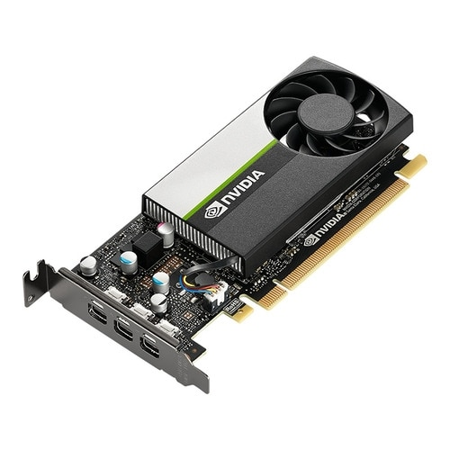
Graphics Card/Chip
A graphics card/chip is a component that creates images that can be displayed on a screen.
A graphics card/chip is responsible for generating 2D & 3D images and performing calculations in order to create them look realistic.
A graphics card/chip will create multiple images (frames) per second. The number of frames/images it can create per second is called the frame rate. A higher frame rate makes changes to the images appear smoother.
The size (Height and Width) of the image is measured in pixels. Each pixel is a dot of colour. The size of an image is referred to as resolution. The bigger/higher the resolution the more detail in the image.
Did you know? Graphics cards/chips have their own Processor and RAM

Slide 6
Sound Card/Chip
A sound card/chip is responsible for generating audio signals that can be sent to a speaker.
A sound card/chip is also responsible for receiving audio signals from a microphone.
Audio is analogue and computers are digital so the sound card/chip has to take measurements (samples) of the audio from the microphone in order to store it on the computer.
In order to turn digital audio into an analogue signal the computer the chip reverses the process of sampling.
High quality audio has over 44,000 samples per second.
Did you know? the higher the number of samples per second the larger the file size.

Slide 7
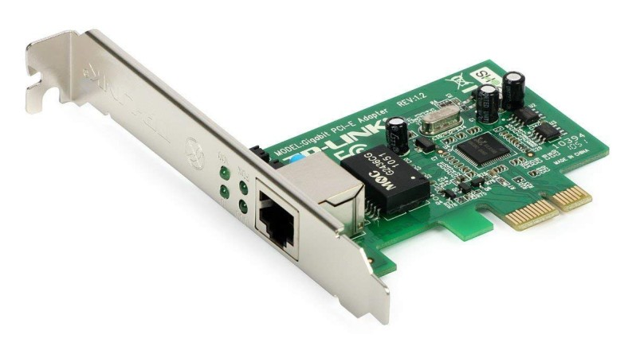
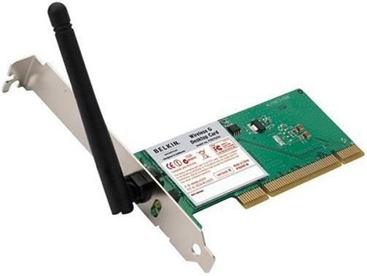
Network Interface Card/Controller
A network interface card/controller allows a computing device to connect to a wired network.
A NIC uses electrical signals for cable or light signals for fibre optic
A wireless network interface card/controller allows a computing device to connect to a wireless network
A WNIC uses radio waves to send and receive data.
Did you know? Wired connections are faster as they don’t get affected by interference.

Slide 8
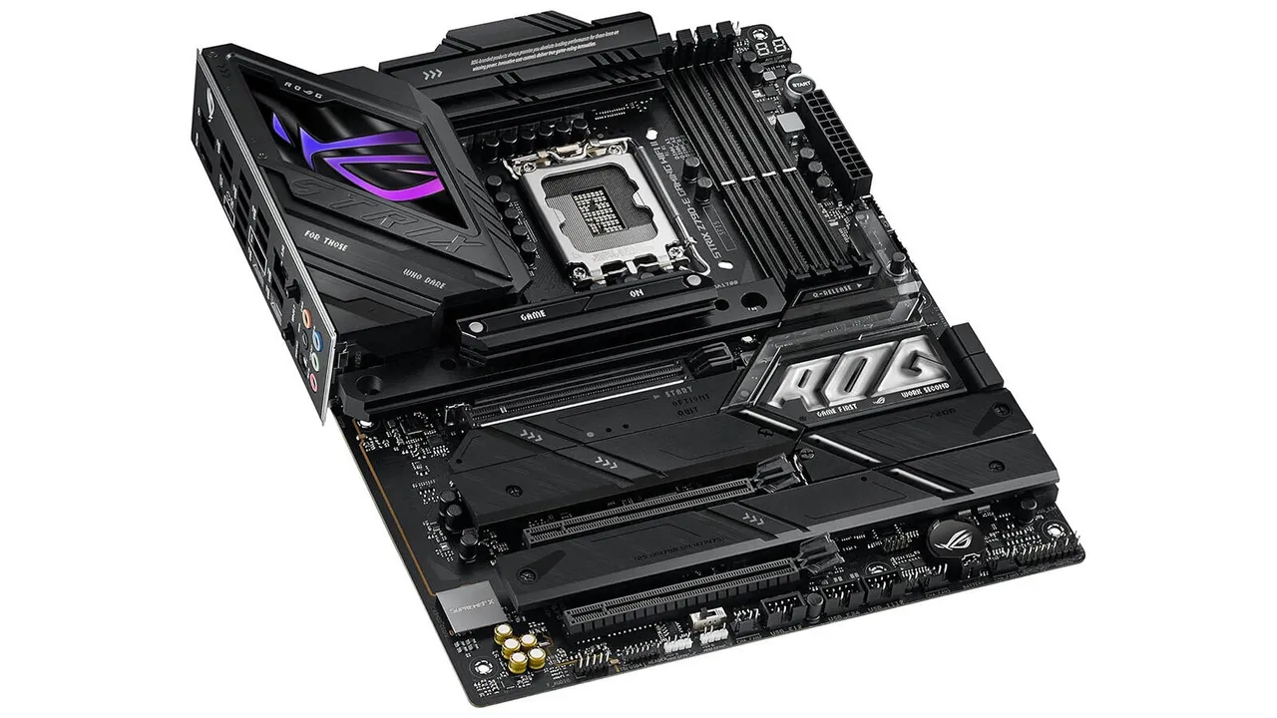
Motherboard
A motherboard is a large circuit board that connects together all the components in a computer. All data has to pass through the motherboard in order to get to another component.
The motherboard contains the BIOS chip which is used to start up a computer.
Did you know? A motherboard is found in every computing device.

