Slide 1

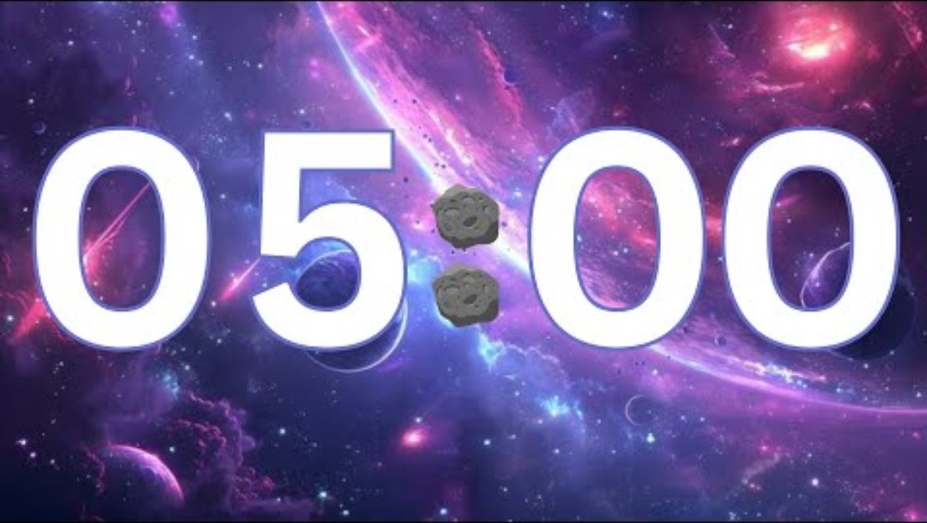
Do Now
Engage
Learn
Build
Apply
Review
1
What is the accumulator?
2
What is the difference between RAM and ROM?
3
Why do computers need Primary Storage?
4
What does ‘volatile’ memory mean?

Slide 2
Topic: J277.1.2.1
Title: Primary Storage
Date: 07/10/2025
Put today’s title and date
Underline both

Slide 3
Knowledge Objectives
The need for primary storage The difference between RAM and ROM The purpose of ROM in a computer system The purpose of RAM in a computer system Virtual memory | Required Why computers have primary storage How this usually consists of RAM and ROM Key characteristics of RAM and ROM Why virtual memory may be needed in a system How virtual memory works Transfer of data between RAM and HDD when RAM is filled

Slide 4
Sub-title: The need for primary storage (Memory)
Write the sub-title and underline
Write the following:
  Why do computer systems need Primary Storage?
    There is a need to have primary memory in order for the computer to have start up information (ROM) and so that the computer can store programs and documents currently in use (RAM).

Slide 5
Sub-title: ROM (Read Only Memory)
Write the sub-title and underline
Write the following:
  ROM – Read Only Memory:
    Is needed on a computer so that when the computer first starts up it can load the BIOS (Basic Input Output System) and configuration settings.
    The ROM chip is built into the motherboard and is read-only so that the computer can always start up. (no risk of data being deleted).
    ROM is non-volatile (Persistent): Data stored does not get wiped when the computer is powered off

Slide 6
Sub-title: RAM (Random Access Memory)
Write the sub-title and underline
Write the following:
  RAM – Random Access Memory:
    Is used to store data currently in use by the system such as programs & documents
    RAM is Volatile Memory (temporary) which means that when the computer is powered down the memory is wiped. RAM needs power in order to retain the data it stores.
    Loading - is the process of moving data to the RAM from other memory/storage
    Saving – is the process of moving data from the RAM to secondary Storage

Slide 7
Saving
CPU
Registers
Primary Memory
RAM
ROM
Secondary Storage
Solid State Drive
Hard Disk
CD/DVD/Blu-Ray
Memory Cards
Memory Stick
Loading

Slide 8
Sub-title: Virtual Memory
Write the sub-title and underline
Write the following:
  Virtual Memory is storage used within secondary storage when storage on RAM has run out.
  Advantage is that computer can continue to run even when it runs out of RAM (instead of halting)
  Disadvantage is that using the secondary storage is much slower than RAM and so a significant delay is added to input/output operations

Slide 9
Sub-title: When is virtual memory used?
Saving
CPU
RAM
Secondary Storage
?
Loading

Slide 10
Sub-title: When is virtual memory used?
Write the sub-title and underline
Write the following:
  Normally a CPU loads data from the RAM which in turn loads data from the secondary storage.
  When the RAM is full then data is loaded into virtual memory instead
Create a flowchart That shows…
  Normal memory operations between CPU, RAM and Secondary storage.
  A decision for when virtual memory needs to be used.

Slide 11
Sub-title:
Exam Style Questions
Write the sub-title and underline
Write out the following questions and answer them.
  Random access memory (RAM) and read only memory (ROM) are different types of memory found in computers.
    What are two items that are stored in RAM?
    What is the main difference between RAM and ROM?
  Virtual memory doesn’t physically exist on a memory chip but is an optimisation technique that is implemented by the operating system.
    What is virtual memory?
    Why is virtual memory needed?

