Slide 1

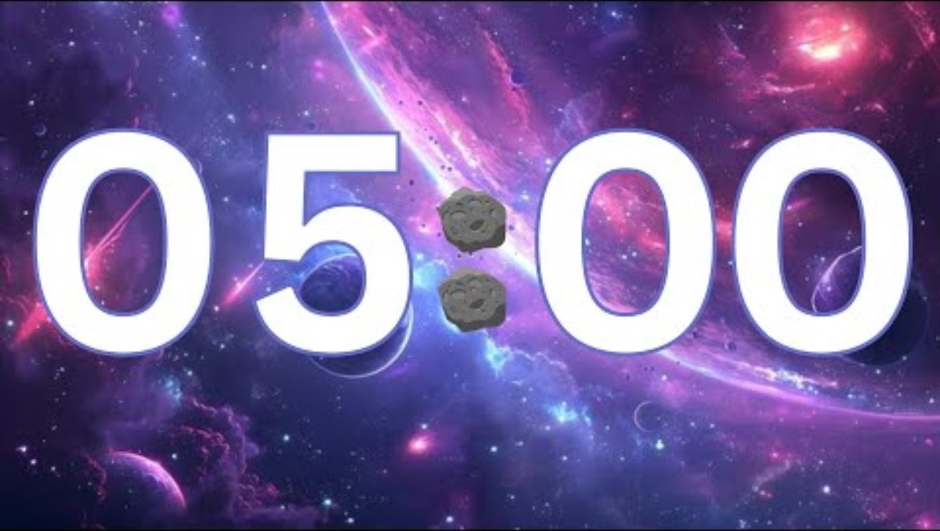
1
What three colours do pixels use?
2
What is meant by colour depth?
3
What is meant by image resolution?
4
How is an image file’s file size calculated?

Slide 2
Topic: J277.1.2.4 Title: Data Storage – Images Date: 07/01/2026
Today’s date:
Put today’s title and date.
Underline both

Slide 3
Knowledge Objectives
Images How an image is represented as a series of pixels, represented in binary Metadata The effect of colour depth and resolution on: The quality of the image The size of an image file | Required Each pixel has a specific colour, represented by a specific code The effect on image size and quality when changing colour depth and resolution Metadata stores additional image information (e.g. height, width, etc.)

Slide 4
Sub-title: Digital images – Pixels, Height & Width
Write the sub-title and underline
Copy out the following information:
Digital images are made up of individual dots of colour.
These dots of colour are called pixels.
Pixels are organised (mapped out) into columns and rows
Each pixel is made up of a mixture of Red, Green & Blue
The number of pixels wide is referred to as the image width
The number of pixels high is referred to as the image height
The height and width of a digital image is called the resolution

Slide 5
Sub-title: Digital images – Colour depth
Each pixel is made up of a mixture of Red, Green & Blue to create the colour needed.
Each pixel is allocated a set number of binary bits to represent the colour. This is referred to as the colour depth.
If each pixel has 8-bit colour-depth then each pixel can be 256 different colours.
If each pixel has 24-bit colour (8-bit for red, 8-bit for green, 8-bit for blue) then it can be 16.7 million colours.
An increase in colour-depth allows a wider range of colours which more accurately represent what we see in real life, however it also means that more data has to be stored which takes up a greater amount of storage space and takes longer to transfer.

Slide 6
Sub-title: Digital images – Metadata
Write the sub-title and underline
Copy out the following information:
Digital image files include additional data stored inside the file called metadata.
Metadata is data about the file such as height, width, colour depth, author, creation date, GPS location, camera lens used, focal point etc

Slide 7
Sub-title: Digital images – Image quality and file size
Write the sub-title and underline
Copy out the following information:
colour depth x image height (pixels) x image width (pixels) + Metadata
Worked example: HD image using 24-bit True Colour
colour depth: 24-bit
Image height: 1080 pixels
Image width: 1920 pixels
= file size of 49,766,400 bits (6,220,000 Bytes / 6.22MB)
Worked example: HD image using 8-bit Colour
colour depth: 8-bit
Image height: 1080 pixels
Image width: 1920 pixels
= file size of 16,588,800 bits (2,073,000 Bytes / 2.07MB)
Reducing the colour depth means that the numbers of colours used is much lower
Fewer colours used means lower image quality.
Fewer colours used means smaller image file size

Slide 8
Sub-title: Digital images – Image quality and file size
Write the sub-title and underline
Copy out the following information:
colour depth x image height (pixels) x image width (pixels) + Metadata
Worked example: UHD image using 24-bit True Colour
colour depth: 24-bit
Image height: 2160 pixels
Image width: 3840 pixels
= file size of 199,065,600 bits (24,883,200 Bytes / 24.88MB)
Worked example: HD image using 24-bit True Colour
colour depth: 24-bit
Image height: 1080 pixels
Image width: 1920 pixels
= file size of 49,766,400 bits (6,220,000 Bytes / 6.22MB)
Reducing the resolution means there are fewer pixels used to make the image which will reduce the level of detail
Pixelation is when there are not enough pixels to fill the space available and so looks blocky as pixels become stretched
Fewer pixels used means lower image quality.
Fewer pixels used means smaller image file size

Slide 9
Sub-title: Digital images – Summary
Write the sub-title and underline
Copy out the following information:
Reducing the resolution reduces the level of detail and leads to pixelation
Reducing the colour depth reduces the colour quality which means it will not reflect the colour it is meant to be
By reducing the resolution or colour depth the file size becomes smaller
By increasing the resolution or colour depth the file size becomes larger

Slide 10
Suitability
What is the advantage of having a greater colour depth?
What is the advantage of having a lower colour depth?
What is the advantage of having a greater resolution?
What is the advantage of having a lower resolution?

Slide 11
Suitability (Answers)
What is the advantage of having a greater colour depth?
Greater colour depth improves image quality by allowing more colours to be shown, making images look more realistic.
What is the advantage of having a lower colour depth?
Lower colour depth reduces file size, making images quicker to store, upload, and download.
What is the advantage of having a greater resolution?
Greater resolution increases the number of pixels, resulting in clearer and more detailed images.
What is the advantage of having a lower resolution?
Lower resolution reduces file size, improving loading speed and reducing storage requirements.

Slide 12
Exam Style Questions
Question 1 (Multiple choice – 1 mark)
What is a pixel?
A. A file format used for images
B. A single dot of colour in a digital image
C. The total size of an image file
D. The number of colours in an image
Question 2 (Short answer – 2 marks)
Define image resolution and explain how it is related to image quality.
Question 3 (Understanding concepts – 3 marks)
An image has a width of 800 pixels and a height of 600 pixels.
Calculate the total number of pixels in the image.
State one effect increasing the number of pixels would have on the image.
Question 4 (Colour depth – 3 marks)
Explain what is meant by colour depth and describe one effect increasing colour depth has on:
Image quality
File size
Question 5 (Calculation – 4 marks)
An image is 1,024 pixels wide and 768 pixels high.
The colour depth is 8 bits per pixel.
Calculate the file size in bytes.
Show all your working.
Question 6 (Extended response – 4 marks)
Compare the effect of increasing resolution and increasing colour depth on:
Image quality
File size

