Slide 1
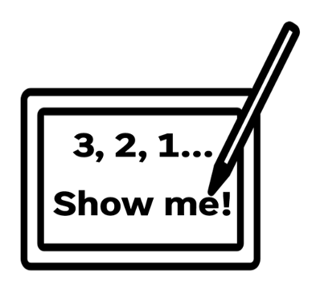

1
What is frequency measured in?
2
What does audio sampling frequency mean?
3
What does audio bit-depth mean?
4
How is a sound file’s file size calculated?

Slide 2
Topic: J277.1.2.4 Title: Data Storage – Sound Date: 08/01/2026
Put today’s title and date.
Underline both

Slide 3
Knowledge Objectives
Images How sound can be sampled and stored in digital form The effect of sample rate, duration and bit depth on: The playback quality The size of a sound file | Required Analogue sounds must be stored in binary Sample rate – measured in Hertz (Hz) Duration - how many seconds of audio the sound file contains Bit depth - number of bits available to store each sample (e.g. 16-bit)

Slide 4
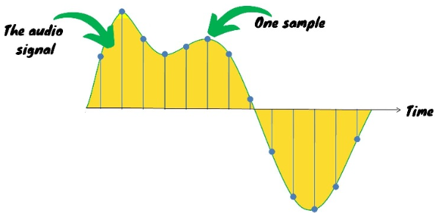
Sub-title: Digital Audio – Samples
Write the sub-title and underline
Copy out the following information:
Sound/audio is analogue.
In order to digitise an analogue audio wave, readings need to be taken of where the analogue wave is at timed intervals.
An individual reading of the analogue wave is called a sample

Slide 5
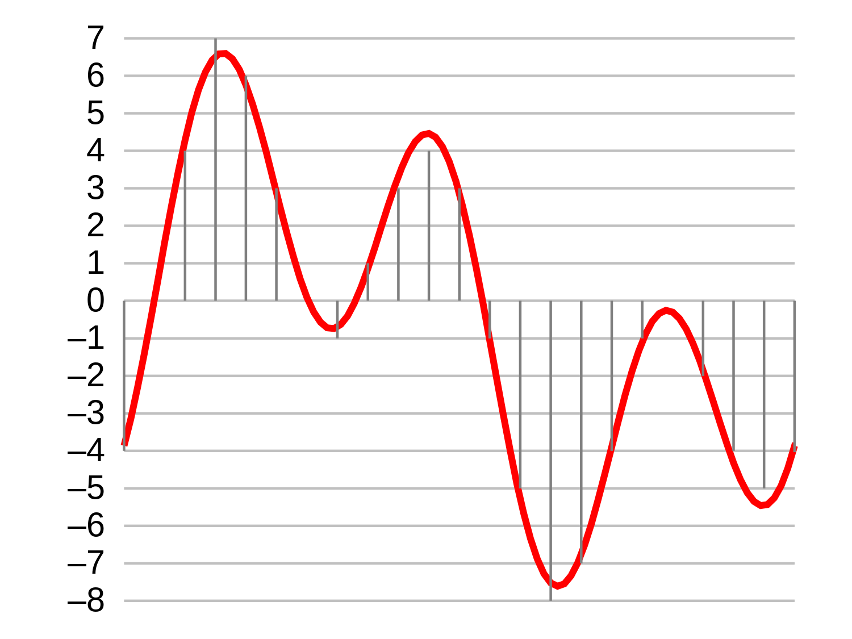
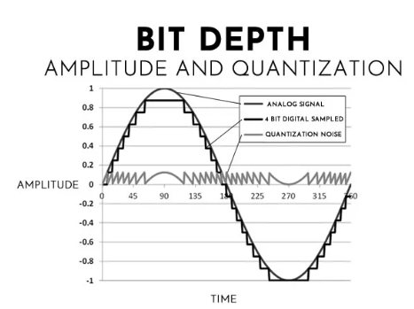
Sub-title: Digital Audio – Sample bit depth
Write the sub-title and underline
Copy out the following information:
The amount of data used to record each sample is called the bit-depth.
The greater the bit-depth the wider the range of possible values that can be used and therefore increasing the level of detail. This means that the sample will more accurately be recorded.
How does bit-depth affect file size and audio quality?
Higher bit-depth = more accuracy & larger file size
Lower bit-depth = less accuracy & smaller file size

Slide 6
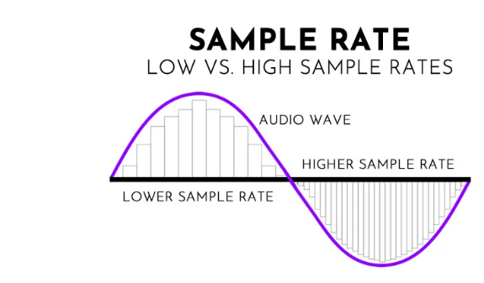
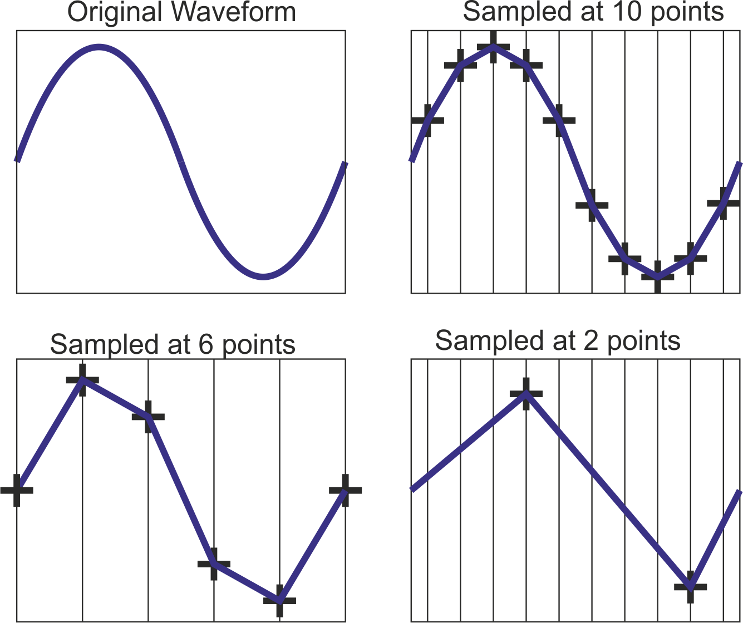
Sub-title: Digital Audio – Sample rate
Write the sub-title and underline
Copy out the following information:
How often a reading of the analogue sound wave is taken is called the sample rate.
How often a something happens is referred to as the frequency and frequency is measured in Hertz (Hz)
Sample rate/frequency and is measured in Hertz (Hz)
How does sample rate affect file size and audio quality?
Higher sample rate = more accuracy & larger file size
Lower sample rate = less accuracy & smaller file size

Slide 7
Sub-title: Digital Audio – Channels
Write the sub-title and underline
Copy out the following information:
Sound can often be made up of different digital audio channels.
Different audio channels help give the illusion of 3D / surround sound
Mono = single channel
Stereo = dual channel
2.1 audio = 3 channel (2 main channels & 1 channel for subwoofer)
5.1 audio = 6 channel (5 main channels & 1 channel for subwoofer)
7.1 audio = 8 channel (7 main channels & 1 channel for subwoofer)

Slide 8
Sub-title: Digital Audio – Standard presets
Write the sub-title and underline
Copy out the following information:
Industry standard presets
Bit depth/amplitude
16-bit (CD quality / up to 96.3 decibels)
24-bit (studio quality / up to 144.5 decibels)
32-bit (Up to 1,528 decibels)
Sample rate/frequency
44.1 KHz (Standard quality)
48 KHz (Film quality)

Slide 9
Sub-title: Digital Audio – File size
Write the sub-title and underline
Copy out the following information:
Bit depth x sample rate (frequency) x duration (seconds) x channels
Worked example:
Bit depth = 16 bit (CD quality)
Sample rate (frequency) = 44.1 KHz (standard quality)
Duration (seconds) = 60 seconds
Channels = 1 (mono)
= 42,336,000 bits (5,292,000 Bytes / 5.3MB)

Slide 10
Sub-title: Digital Audio – Summary
Write the sub-title and underline
Copy out the following information:
Number of samples per second = Sample rate/frequency (measured in Hertz)
Accuracy of height of sound wave = Amplitude resolution of each sample = Bit depth
Higher number of samples = higher quality audio & more data to store (larger file size)
Higher bit depth = higher quality audio & more data to store (larger file size)

Slide 11
Calculate
Calculate the following file sizes:
Scenario 1 – 30 second mono audio with a sample rate of 44.1KHz and 16-bit depth.
Scenario 2 – 90 second Stereo audio with a sample rate of 44.1KHz and 16-bit depth.
Scenario 3 – 3 minute Stereo audio with a sample rate of 44.1KHz and 16-bit depth.
Scenario 4 - 4 minute 2.1 channel audio with a sample rate of 44.1KHz and 16-bit depth.
Scenario 5 - 3 minute 9 seconds 5.1 audio with a sample rate of 44.1KHz and 16-bit depth.
Scenario 6 - 60 minute mono audio with a sample rate of 44.1KHz and 8-bit depth.

Slide 12
Suitability
In what scenario would a low audio bit-depth be more appropriate?
In what scenario would a high audio bit-depth be more appropriate?
In what scenario would a high sampling frequency be more appropriate?
In what scenario would a low sampling frequency be more appropriate?

Slide 13
Suitability (Answers)
In what scenario would a low audio bit-depth be more appropriate?
A low audio bit-depth is more appropriate for speech-based audio, such as phone calls or voice recordings.
This is because speech does not require a wide range of volume levels, and a lower bit-depth reduces file size while keeping the audio clear enough.
In what scenario would a high audio bit-depth be more appropriate?
A high audio bit-depth is more appropriate for music production or professional audio recording.
This is because a higher bit-depth allows a greater range of sound levels, reducing distortion and improving sound quality.
In what scenario would a high sampling frequency be more appropriate?
A high sampling frequency is more appropriate when recording music or complex sounds, such as studio recordings or live concerts.
This is because a higher sampling rate captures more sound samples per second, making the recording more accurate to the original sound.
In what scenario would a low sampling frequency be more appropriate?
A low sampling frequency is more appropriate for voice-only audio, such as telephone calls or online voice chats.
This is because human speech does not contain many high frequencies, so a lower sampling rate is sufficient and produces smaller file sizes.

Slide 14
Exam Style Questions
Question 1: [2 marks]
What is meant by bit-depth in digital audio storage?
Question 2: [2 marks]
Explain what sampling frequency means when storing sound digitally.
Question 3: [3 marks]
A piece of audio is recorded in stereo rather than mono.
a) State the difference between mono and stereo audio.
b) Explain how using stereo instead of mono affects the file size
Question 4: [4 marks]
Explain how increasing the bit-depth of an audio file affects:
the range of sound levels that can be stored
the size of the audio file
Question 5: [3 marks]
Explain why a higher sampling frequency results in a more accurate digital representation of sound.
Question 6: [4 marks]
A mono audio recording has:
a sampling frequency of 44,100 Hz
a bit-depth of 16 bits
a duration of 10 seconds
Calculate the file size in bits of this audio recording.

