Slide 1


1
What does ‘performance’ mean?
2
What causes a network slow down?
3
What can be done to reduce network latency?
4
Why is network latency a problem?

Slide 2
Topic: J277.1.3.1
Title: Factors that affect Network Performance
Date: 26/02/2026
Put today’s title and date.
Underline both

Slide 3
Knowledge Objectives
Factors that affect the performance of networks | Understanding of different factors that can affect the performance of a network, e.g.: Number of devices connected Bandwidth

Slide 4
Keyword
Keyword: Network performance
Definition: Network performance refers to how well a computer network operates, including how quickly and reliably data is transferred between devices. It is commonly measured using factors such as speed (bandwidth), delay (latency), reliability, and error rates. In GCSE Computer Science terms, it describes how efficiently a network handles data communication.
Synonyms: Network efficiency, System performance, Data transmission quality

Slide 5
Keyword
Keyword: Performance
Definition: Performance refers to how quickly and efficiently a system or network operates, including how fast data is processed and transferred and how reliably tasks are completed.
Synonyms: Speed, Efficiency, Responsiveness

Slide 6
Sub-title:
Factors that affect network performance
Write the sub-title and underline
Write the following:
  Number of devices: The greater the number of devices using a network the greater the time the device may have to wait its turn to transmit and receive data. More devices sharing resources mean that each devices gets a smaller portion of time and so will lower the speed due to latency/waiting times.
  Bandwidth: The greater the bandwidth, the more resource there is to share. Bandwidth refers to the connection speed which is then shared across devices. Each device will get the line for a period of time. The higher the bandwidth the quicker it can transfer the data.

Slide 7
Sub-title:
Factors that affect network performance
Collisions: A collision is when 2 or more packets of data are transmitted at the same time and therefore the data becomes combined and no longer usable.
  Modern Wired networks do not have packet collisions as the data is only sent on when the line is free.
  Detecting or preventing collisions on a wireless network is not always possible as the sender may not always know there has been a collision.
Distance: On a wired/wireless network there may be degradation of signal over distance and so the signal will become fainter and less detectable.

Slide 8
Sub-title:
Factors that affect network performance
Interference: is when a 3rd party causes degradation or loss of signal quality which means that data cannot be transferred as efficiently as it will need to be sent at a slower speed or more than once. Examples of this might be electromagnetic interference near a wire, or digital noise affecting wireless such as a device with a motor in it emitting wireless signals by accident, another wireless device transmitting on the same channel at the same time, Microwave oven creating radio waves.

Slide 9
Sub-title:
Factors that affect network performance
Number of devices: The greater the number of devices using a network the greater the time the device may have to wait its turn to transmit and receive data. More devices sharing resources mean that each devices gets a smaller portion of time and so will lower the speed due to latency/waiting times.

Slide 10
Sub-title:
Factors that affect network performance
Bandwidth: The greater the bandwidth, the more resource there is to share. Bandwidth refers to the connection speed which is then shared across devices. Each device will get the line for a period of time. The higher the bandwidth the quicker it can transfer the data.

Slide 11
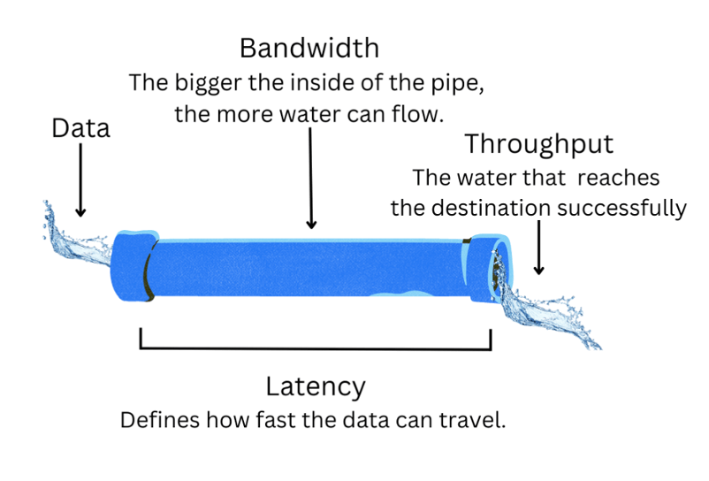
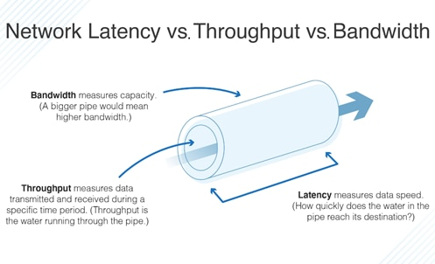
Understanding Bandwidth, Throughput & Latency
Notes:
Images copyrighted?

Slide 12
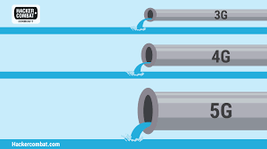
Mitigating problems with network latency
Reducing the number of network users
  Reduces potential for data packet collisions
  Reduces amount of data being sent/received
Give certain types of traffic a priority of service
Increase bandwidth
Remove interference
Reduce distance

Slide 13
Scenarios – How can the issue be mitigated?
Scenario 1 – Busy Household
  At 7pm, five people in a house are all using the internet at the same time:
    Two are streaming films in 4K.
    One is gaming online.
    One is on a video call.
    One is downloading a large game update.
  Suddenly, the video call starts lagging and the films begin buffering.
Scenario 2 – School Lunchtime Slowdown
  At a secondary school, the internet works well during lessons.
  However, during lunchtime, hundreds of students connect their phones to the WiFi.
  Teachers report that:
    Online registers load slowly.
    Websites take longer to open.
    Some video clips fail to play.
Scenario 3 – Small Business Upgrade
  A small business has 8 employees.
  They regularly:
    Upload large design files.
    Hold video meetings.
    Use cloud-based software.
  They currently have a 20 Mbps internet connection.
  The manager is considering upgrading to 200 Mbps.
Scenario 4 – New Housing Estate
  A new housing estate has recently been built.
  All homes are connected to the same local broadband infrastructure.
  In the evenings:
    Streaming services buffer.
    Online gaming has high lag.
    Downloads are very slow.
  During the daytime, speeds are much faster.
Scenario 5 – Office WiFi Issue
  An office has recently added 15 new laptops to its network.
  The WiFi router has not been upgraded.
  Staff complain that:
    The signal drops out.
    Video calls freeze.
    File transfers take longer than before.

Slide 14
Exam style questions
Question 1 (2 marks)
  State two factors that can affect the performance of a network.
Question 2 (3 marks)
  Explain how the number of devices connected to a network can affect its performance.
Question 3 (3 marks)
  Explain how bandwidth affects the speed and reliability of a network.
Question 4 (4 marks)
  A school network becomes very slow at lunchtime when many students are using it.
  Explain two reasons why this might happen.
Question 5 (6 marks)
  A small business is experiencing slow internet speeds when staff are video conferencing and uploading files.
  Discuss how bandwidth and the number of connected devices can affect network performance.
  In your answer, include:
    An explanation of both factors
    The impact on users
    At least one possible solution

