Slide 1
J277 Computer Science
2.1.1 – Designing, creating and refining algorithms

Slide 2
 | Required
Identify the inputs, processes, and outputs for a problem Structure diagrams Create, interpret, correct, complete, and refine algorithms using: Pseudocode Flowcharts Reference language/high-level programming language Identify common errors Trace tables | Produce simple diagrams to show: The structure of a problem Subsections and their links to other subsections Complete, write or refine an algorithm using the techniques listed Identify syntax/logic errors in code and suggest fixes Create and use trace tables to follow an algorithm

Slide 3
How to identify the inputs, processes and outputs for a problem
In order to identify the inputs, process and outputs for a problem you first of all use abstraction and decomposition to understand what the problem is.
Using algorithmic thinking (Sequencing, selection & iteration) you can then design a possible solution using a structure diagram, flowchart or pseudocode.
As you design the solution you will identify when input and output will be needed and what processes & sub-processes will be required.

Slide 4
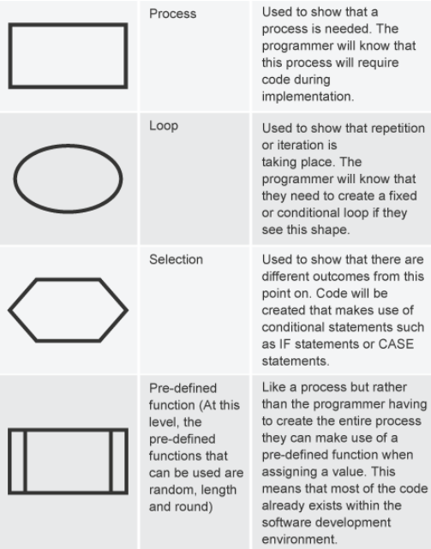
Structure Diagrams
(source bbc.co.uk)
As structure diagram is a visual design technique used to show the steps involved in a solution. With a structure diagram you would start at the top and work your way down. Structure diagrams are similar to flowcharts which are also a visual design technique.

Slide 5
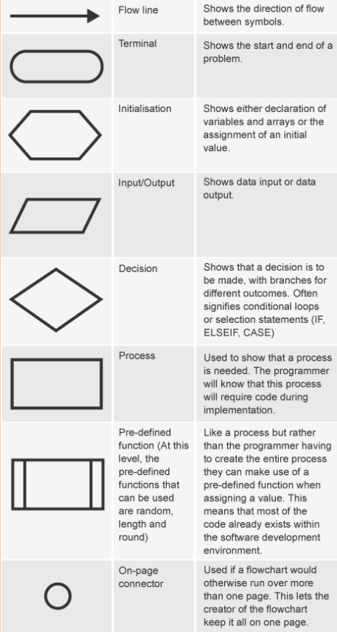
How to create, interpret, correct, complete and refine an algorithm
Using flowcharts
An algorithm is a method (way of doing things) used to make something happen (i.e. solve a problem).
A flow chart shows the algorithm as a sequence of actions represented in a graphical form. The flow chart may have options/decisions and will allow you to follow the different possible outcomes.
Creating a flow chart allows you to identify a possible solution to a problem and to identify possible problems that may arise.
A flow chart can easily have more information added to it so it can slowly be built up into a more complex algorithm.

Slide 6
How to create, interpret, correct, complete and refine an algorithm
Using pseudocode
is a written version of a graphical flow chart.
is written in a generic language (plain English!) which can be understood by anyone and then transposed into any chosen programming language.
helps the programmer to understand the processes/steps involved in the program.

Slide 7
How to create, interpret, correct, complete and refine an algorithm
Using high-level programming language
High-level languages: is a programming language that is more complex than a low-level programming language. High-level languages are written using keywords as commands. The keywords/commands invoke multiple actions. Just a few keywords are needed in order to create a complex program. high-level languages need to be converted into machine code in order to be processed/executed by the processor.
High-level programming languages can be used to ‘design as you code’ a possible solution. As the programming language is complex & powerful it can be a design method of trying different scenarios quickly to see what might happen.

Slide 8
How to identify common errors
Logic
A logic error is when the code will run but the response (outcome/ouput) is not correct. This could be due to the order in which the code is processed or incorrect operator.
Syntax
A syntax error is when the code will not run because there has been an error with the spelling/grammar/layout of the code.

Slide 9
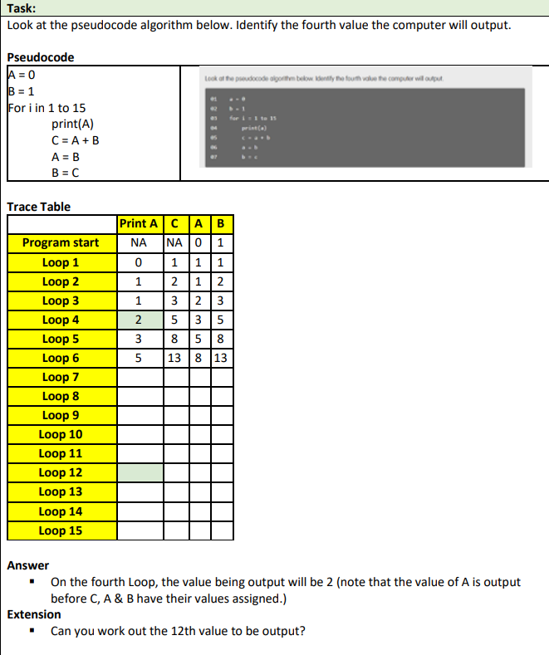
How to create a trace table
The purpose of a Trace-Table is to allow you to dry-run a program and track changes to different variables.

