Slide 1
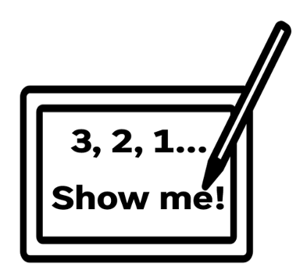
1
What is a programming language?
2
Give an example of a programming language
3
What is a programming error?
4
Give an example of a programming error

Slide 2
Topic: KS3 Python101 Title: L1 - Getting started with Python Date: 31/03/2026

Slide 3
Knowledge Objectives
Learning objectives
What Python is What an IDE is How to load the Python programming environment How to print information to the screen How to create and run a program How to Save and open a program Types of error messages

Slide 4
Keyword
Keyword: Python
Definition: A high-level programming language used to write instructions that a computer can understand and execute.
Synonyms:
Programming language
Scripting language
High-level language
Keyword: IDE (Integrated Development Environment)
Definition: An IDE is a software application that provides programmers with a complete set of tools to write, edit, run, and debug code in one place. It typically includes a code editor, compiler or interpreter, and debugging tools.
Synonyms:
Code editor (enhanced)
Development environment
Programming environment

Slide 5
Launching a Python IDE
Demo from teacher:
How to launch a Python IDE
How to save python code
How to run python code
Syntax errors

Slide 6
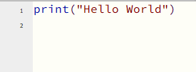
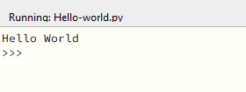
Activity 1
Create your first python project
Hello-world.py

Slide 7
Common Errors
Often when you write a program and you are testing it you will get an error message. There are 2 main types of error message:
Syntax error:
is an error in spelling or grammar. The error message will often tell you which line the error is on so that you can find it and solve it. When the program is compiled, it is strict when it checks and processes each command. If you mistype the name of a function or lay out the document wrong this will not be what it is expecting and so produce an error.
Logic error:
is a bug in a program that causes it to operate incorrectly/ you will not get an error message when you have an error message, however the expected outcome will not be correct. For example, if you check if a value is greater than 10 but accidentally use a less-than symbol rather than a greater-than symbol, this is a logic error

Slide 8
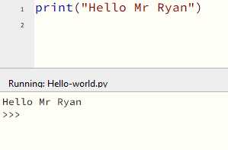
Activity 2
Amend hello-world.py so that it says “Hello” and then your name.
Save the file as hello-name.py
Run the code

Slide 9
Questions
Explain what Python is
What is a Syntax error?
What is a Logic error?
What file extension does python use?
What is an IDE?

Slide 10
Syntax error or logic error?
Scenario 1 (The program will not run and shows an error message.)
print("Hello World“
Scenario 4 (It runs, but only prints 1 to 4.)
for i in range(1, 5):
print(i)
Scenario 2 (The program runs, but gives the wrong answer)
price = 10
quantity = 5
total = price – quantity
print(total)
Scenario 5 (The program crashes when it runs.)
print("Score: " + 10)
Scenario 6 (The program runs correctly, but the student says the result is wrong for their test case.)
age = 16 if age >= 18: print("You can vote") else: print("You cannot vote")
Scenario 3 (The program will not run.)
if x = 5: print("Correct")

Slide 11
Syntax error or logic error? (answers)
Scenario 1 (The program will not run and shows an error message.)
print("Hello World“)
Syntax error
Scenario 4 (It runs, but only prints 1 to 4. and the user wants 1 to 5)
for i in range(1, 6):
print(i)
Logic Error
Scenario 2 (The program runs, but gives the wrong answer)
price = 10
quantity = 5
total = price * quantity
print(total)
Logic Error
Scenario 5 (The program crashes when it runs.)
print("Score: " + str(10))
Syntax error
Scenario 6 (The program runs correctly, but the student says the result is wrong for their test case.)
age = 16 if age >= 18: print("You can vote") else: print("You cannot vote")
Logic Error – user logic is incorrect
Scenario 3 (The program will not run.)
if x == 5: print("Correct")
Syntax error

