Slide 1


1
Describe a conditional statement
2
Describe user input
3
Why might programs need conditional statements?
4
Why might programs need user input?

Slide 2
Topic: KS3 Python101 Title: L3 – Input & Conditional Statements Date: 31/03/2026

Slide 3
Knowledge Objectives
User input What user input is How to store user input How to convert user input How to output user input Conditional statements What a conditional statement is The difference between if, elif and else

Slide 4
Keyword
Keyword: User input
Definition: User input is any data or instruction that a user provides to a computer system so it can be processed.
Synonyms:
Input
User data
Entered data
Keyword: Conditional statement
Definition: A conditional statement is a command that allows a program to make decisions by running different code depending on whether a condition is true or false.
Synonyms:
Selection
Decision statement
If statement

Slide 5
Demonstration
User input
Collecting a user input and storing it in a variable

Slide 6
Activity 1
Collect user input and store it in a variable.
Use your knowledge from last lesson to…
Print the variable to the screen.
Concatenate the input with a string and print it to the screen.
var1 = input(“What is your name?”)

Slide 7
Demonstration
Conditional statements

Slide 8
Activity 2
Create a conditional statement
Run the code with var1 set to
15
16
17
Use your knowledge from lesson 1.
What type of error happens when you set var1 to A
What type of error happens when you set var1 to “A”
var1 = 16
if var1 > 16:
print (“Greater than 16”)
elif var1 < 16:
print (“Less than 16”)
else:
print (“Same”)

Slide 9
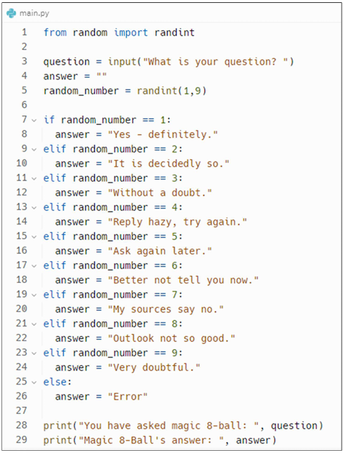
Activity
Create the magic 8-ball game.
Add code comments for as many lines as possible describing what they do.
Edit the game so the existing outcomes are different or edit the game so there is more than 9 possible outcome.

Slide 10
Questions
Describe a conditional statement and give an example.
Describe user input and give an example.
Why might programs need conditional statements?
Why might programs need user input?

