Slide 1
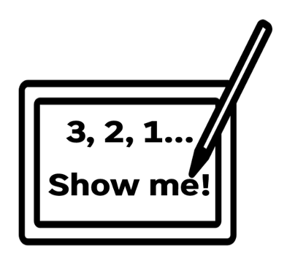

1
Why do we use loops to repeat code?
2
Give the name of a loop type
3
What is a For loop?
4
What is a While loop

Slide 2
Topic: KS3 Python101
Title: L4 – Loops
Date: 31/03/2026

Slide 3
Knowledge Objectives
Difference between count-controlled loops and condition-controlled loops. What a for loop is How to use a for loop What a while loop is How to use a while loop Risk associated with while loops

Slide 4
Keyword
Keyword: Count controlled loop
Definition: A count-controlled loop is a loop that repeats a specific number of times, usually using a counter variable to keep track of how many times it has run.
Synonyms:
  For loop
  Fixed loop
  Definite loop
Keyword: Condition controlled loop
Definition: A condition-controlled loop is a loop that continues to repeat while a condition is true and stops when the condition becomes false.
Synonyms:
  While loop
  Conditional loop
  Pre-condition loop

Slide 5
Demonstration
Count controlled loop

Slide 6
Activity 1
Count controlled loop.
  What do you think this piece of code will do?
  Run the piece of code
  Modify the code so that still using a loop it prints numbers 1 to 10 on the screen.
for i in range(1,6):
print(i)

Slide 7
Demonstration
Condition controlled loop

Slide 8
Activity 2
Condition controlled loop
  What do you think this piece of code will do?
  Run the piece of code
  Why doesn’t it stop running?
  What data type is var1?
Use your knowledge from lesson 3 (user input & conditional statements)
  Update the code so that it collects an input from the user which asks them if they want to keep on looping. If they do var1 should stay as True, if they do not then var1 should change to False.
var1 = True
while var1== True:
print(“I Love Computing!”)

Slide 9
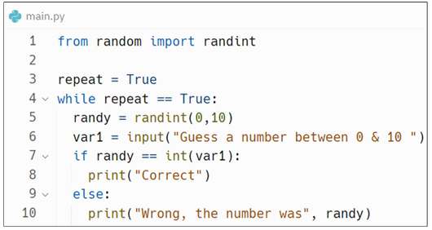
Activity 3
Amend
What do you think this code does?
Is it an example of a count controlled loop or a condition controlled loop?
Run the code

Slide 10
Activity 4
Amend
What do you think this code does?
Is it an example of a count controlled loop or a condition controlled loop?
Run the code
print("Welcome to FizzBuzz")
userinput = input("Please enter a number: ")
for i in range (1, int(userinput) + 1):
if i % 3 == 0 and i % 5 == 0:
print("FizzBuzz")
elif i % 3 == 0:
print("Fizz")
elif i % 5 == 0:
print("Buzz")
else:
print(i)

Slide 11
Questions
Why do we use loops to repeat code?
Give the name of 2 loop types
  ? Controlled loop
  ? Controlled loop
For loop is an example of which loop type?
While loop is an example of which loop type?
What risk is associated with a while loop?

