Slide 1

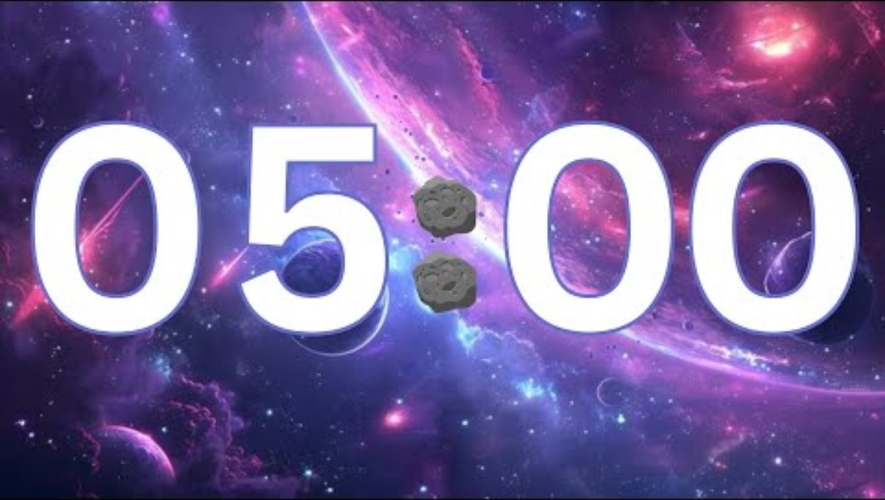
1
What is a function?
2
What is an advantage of a function?
3
4

Slide 2
Topic: KS3 Python101
Title: L5 – Functions
Date: 31/03/2026

Slide 3
Knowledge Objectives
What a Function is How to call a Function How to pass information to a Function How to receive information from a Function

Slide 4
Keyword
Keyword: function
Definition: A function is a reusable block of code that performs a specific task and can be called whenever it is needed in a program.
Synonyms:
  Procedure
  Subroutine
  Method

Slide 5
Demonstration
Demo from teacher on how to create a function

Slide 6
Activity 1
What do you think these 2 programs do?
Run the first lot of code (save as func1.py)
Run the first lot of code (save as func2.py)
#program1
def myfunc(myfname):
print(“My first name is: %s” % myfname)
myfunc(“Dave”)
#program2
def myfunc(myfname, mylname):
print(“My first name is: %s and my last name is %s” % (myfname, mylname))
myfunc(“Dave”, “Smith”)

Slide 7
Activity
What do you think this piece of code does?
Run the code.
Which type of loop is being used?
Add code comments to describe what each line of code does.
def myfunc(count):
n = 0
while n < count:
print(n)
n = n + 1
var1 = input(“Please enter a number: “)
myfunc(var1)

Slide 8
Challenge
Create a program that can convert
  Celsius to Farenheit
  Farenheit to Celsius
  KM to miles
  Miles to KM
The user should be prompted for a choice of 1, 2, 3, or 4. the program will then use a conditional statement to call the correct function.
(Use the code to help you get started
def CtoF(val):
?
def FtoC(val):
?
def KtoM(val):
?
def MtoK(val):
?
int(var1) = input(“?”)
int(var2) = input(“?”)
If var1== 1:
?
Elif var1==2:
?
Elif var1==3:
?
Elif var1==4:
?

Slide 9
Questions
What is a function?
What is an advantage of a function?
How do you pass information to a function?
How do you receive information from a function?

