Slide 1
Spreadsheets
Lesson 1 – Battleships

Slide 2
Do Now
What is a column?
What is a row?
What is a cell?
What is a cell-reference?

Slide 3
Skills checklist
Practising existing skills:
Learning new skills:
Borders
Background colours
Adding text to a cell
Identifying cells, columns, rows
Using cell references
Text formatting (Bold)

Slide 4
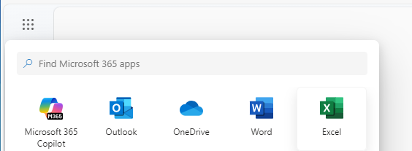
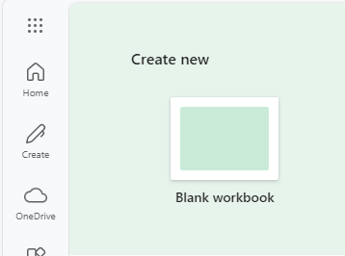
Launching Excel
Log in to www.office.com
In the top menu (9 dots) select Excel
Select Blank Workbook

Slide 5
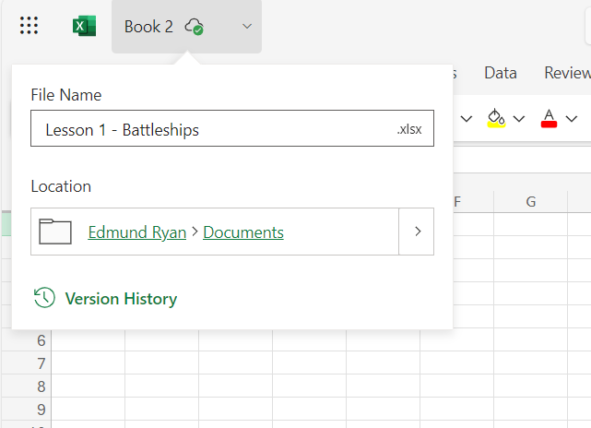
Saving
Save your work with an appropriate name e.g. Lesson 1 – Battleships.xlsx

Slide 6
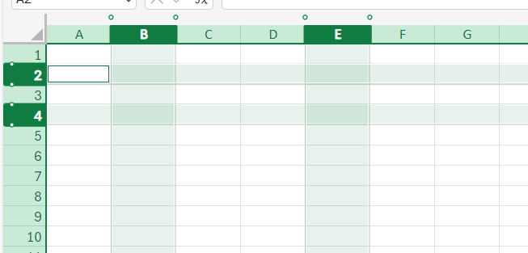
Step 1 – Columns & Rows
All columns are labelled with a letter.
Highlight Column E
Highlight Column B
All rows are labelled with a number.
Highlight Row 4
Highlight Row 2

Slide 7
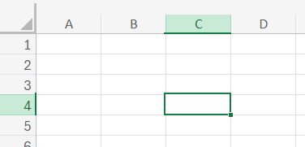
Step 2 – Cell References
Each cell has a reference to identify its location.
The cell reference includes the column first and then the row.
e.g. C4

Slide 8
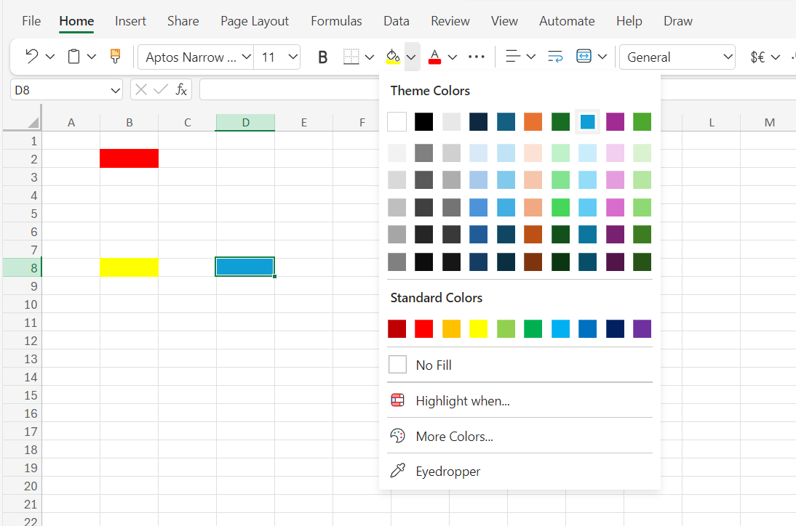
Step 3 – Background Colours
Set the background colour of
B4 to Red
B8 to Yellow
D8 to Blue
Now set the background colour of cells B4, B8 & D8 to 'No fill'

Slide 9
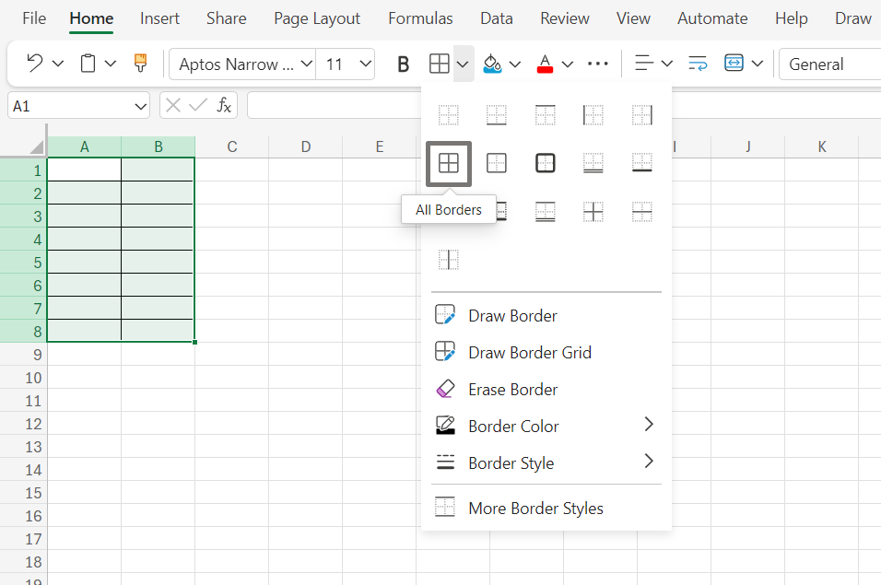
Step 4 - Borders
Select A1:B8
Add a border to cells A1:B8

Slide 10
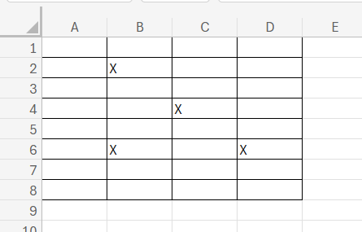
Step 5 - Battleships
Add a border to cells A1:E8
Put an X in any 5 cells
Your teacher will now call out the location of the bombs being dropped.
Colour the cells Red. If it lands on an X, you've lost one of your ships!

