Slide 1
Spreadsheets
Lesson 4 – Charts and Graphs

Slide 2
Do Now
Which function is used to calculate the lowest value?
Which function is used to calculate the highest value?
In Excel which arithmetic symbol is used for division?
In Excel which arithmetic symbol is used for multiplication?

Slide 3
Skills checklist
Practising existing skills:
  Selecting cell ranges
Learning new skills:
  Creating charts and graphs
    Selecting data
    Selecting titles
    Pie chart
    Column chart
    Line chart
  Formatting charts and graphs
    Titles
    Axes titles
    Axis titles

Slide 4
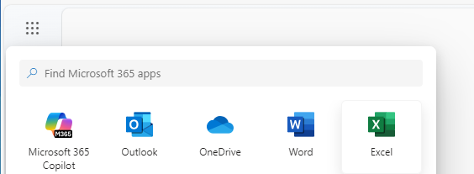

Launching Excel
Log in to www.office.com
In the top menu (9 dots) select Excel
Select Blank Workbook

Slide 5
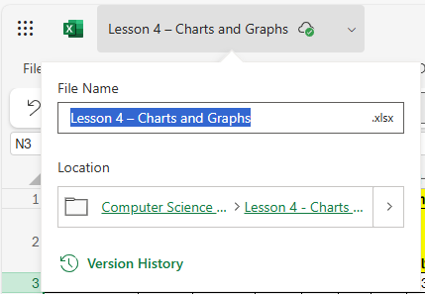
Saving
Save your work with an appropriate name e.g.
Lesson 4 – Charts and Graphs.xlsx

Slide 6
Step 1 – Pie Chart
Create a pie chart that shows the total year sales for all items.
  Labels - A3:A13
  Data - N3:N13
  Add in a chart title
  Add in data labels

Slide 7
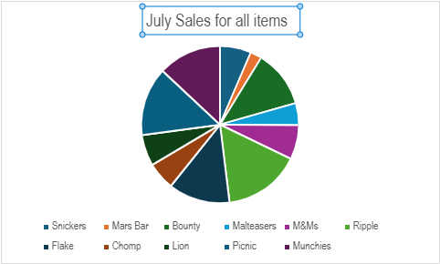
Step 2 – Pie Chart
Create a pie chart that shows the July sales for all items.
  Labels – ??
  Data – ??
  Add in a chart title
  Add in data labels

Slide 8
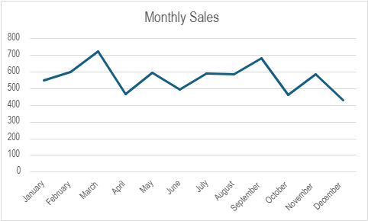
Step 3 – Line chart
Create a line chart that shows the monthly sales for all the items.
  Labels – B2:M2
  Data – B14:M14
  Add in a chart title
  Add in data labels

Slide 9
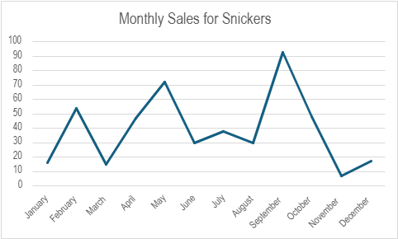
Step 4 – Line chart
Create a line chart that shows the monthly sales for Snickers.
  Labels – ??
  Data – ??
  Add in a chart title
  Add in data labels

Slide 10
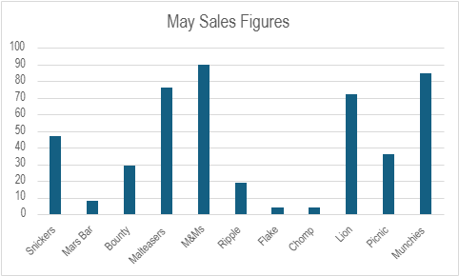
Step 5 – Column Chart
Create a column chart that shows May sales for all items
  Labels - A3:A13
  Data - F3:F13
  Add in a chart title
  Add in data labels

Slide 11
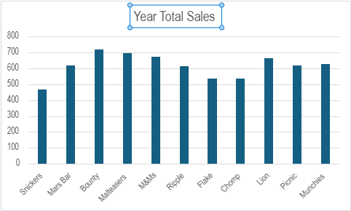
Step 6 – Column Chart
Create a column chart that shows total year sales for all items.
  Labels –
  Data –
  Add in a chart title
  Add in data labels

