Slide 1
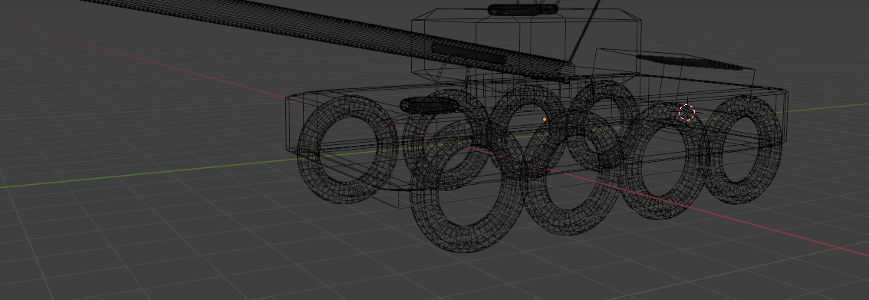

3D Modelling in Blender
Beginner’s guide

Slide 2
You’re going to create a 3D model…
Steam locomotive
Car
Bus
Lorry
Tank
Submarine
UFO
Space shuttle/rocket
A different design of your choice!

Slide 3

Navigation tools
Middle mouse button
Hold down middle button and move mouse: rotates view perspective
Scroll: zoom in/out
Hold down shift and middle button: changes view perspective
Left mouse button
Click: selection
Right mouse button
Click: options

Slide 4
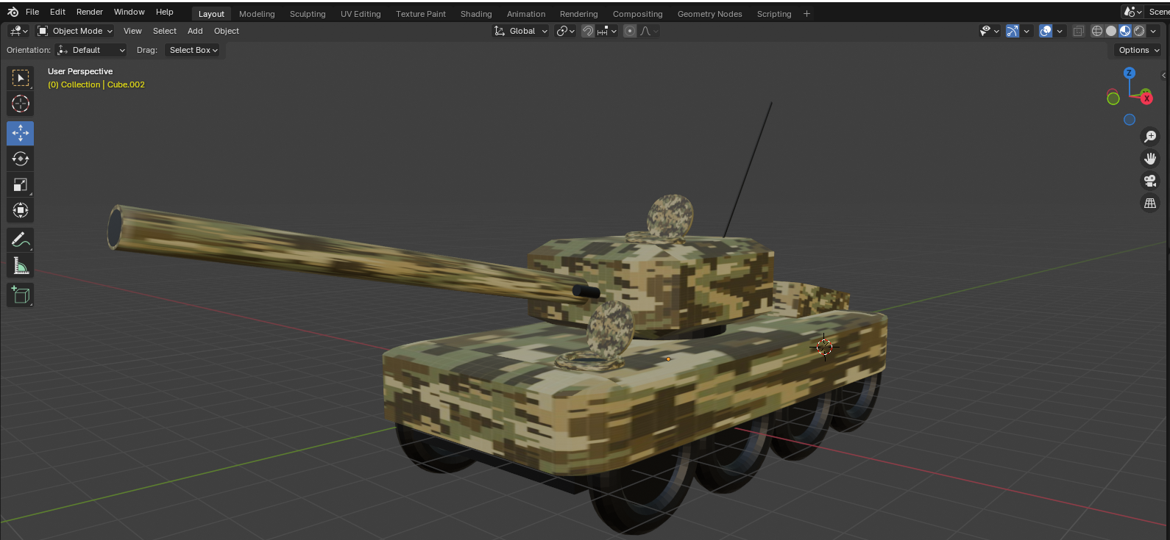
Commonly used tools
Selection
Movement
Rotation
Scale/Resize

Slide 5
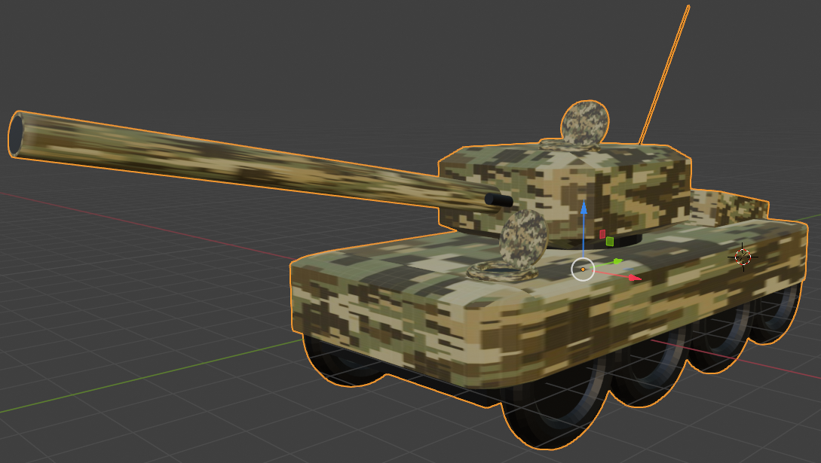
Commonly used tools
Tip: When using the movement, rotation, or scale tool, once an object has been selected a Blue, Red and Green arrow appears.
If you drag these arrow it will keep your object aligned and will move smoothly along the axis.
If you drag the object (not the arrows) it will move the object on all 3 axis and may not align to your other objects.

Slide 6
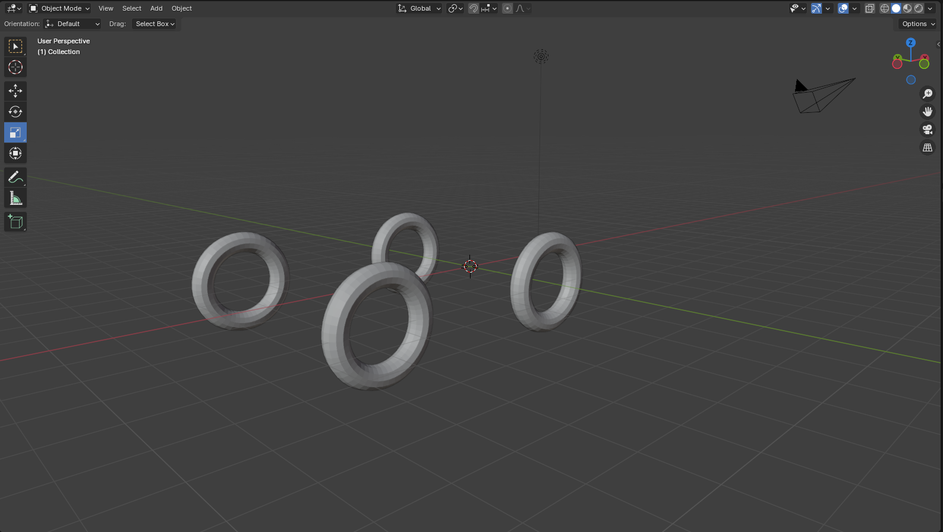
Adding the Wheels
Add > Mesh > Torus
Rotate tool
Movement tool
Tip: right click on an object and then select ‘duplicate objects’. Click immediately and then use the movement tool to reposition it.

Slide 7
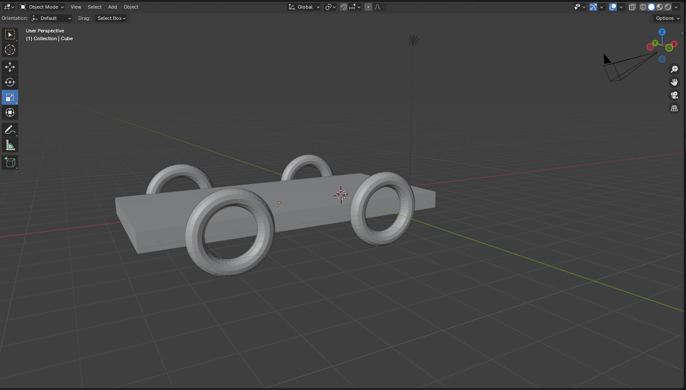
Adding objects: Cube
Add > Mesh > Cube
Scale tool
Movement tool

Slide 8
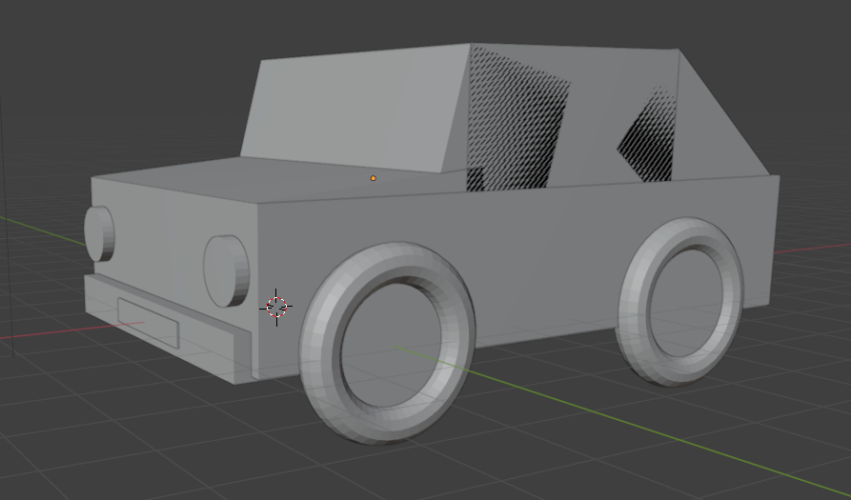
Adding objects
Add additional objects until you are happy with the layout.
Tip: change the view perspective to make sure the vehicle looks good from different angles

Slide 9
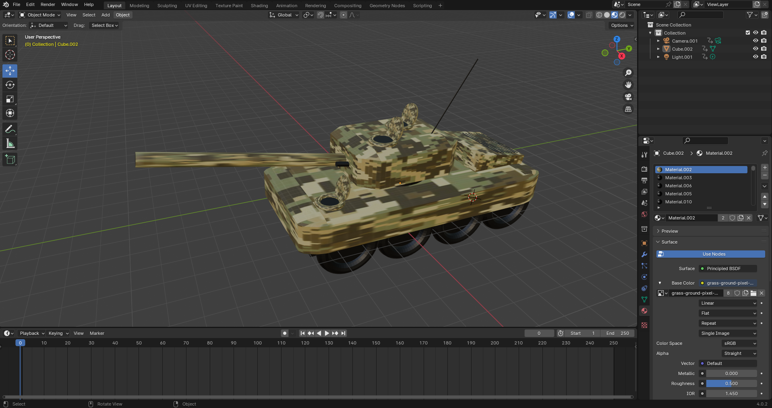
Adding colour (Step 1)
Select: Viewport shading: Display in ‘material preview mode’

Slide 10
Adding colour (Step 2)
Select: ‘material’

Slide 11
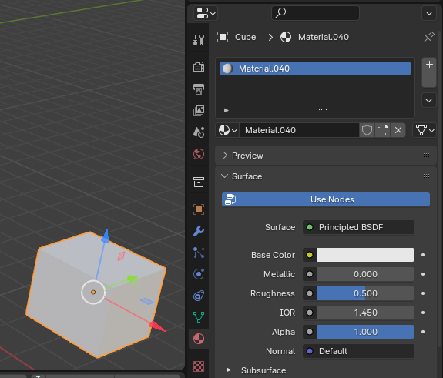
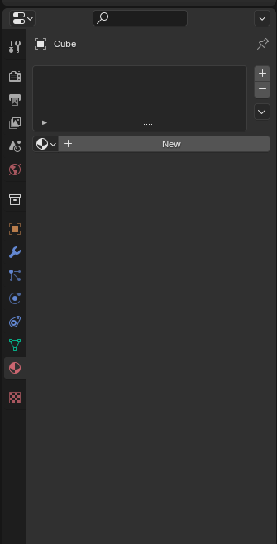
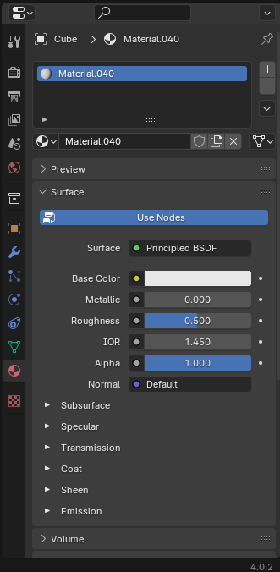
Adding colour (Step 3)
Select the object you wish to colour
Select ‘New’
Select a ‘Base Colour’

Slide 12
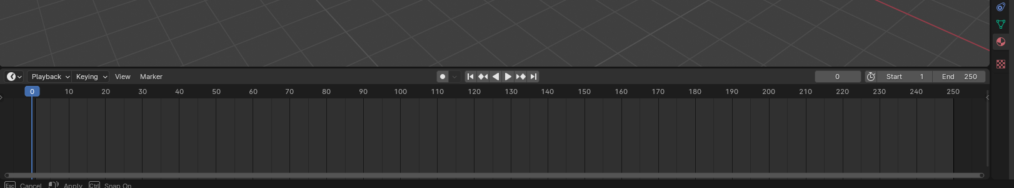
Adding animation (Part 1)
Unhide the timeline by dragging it up from the bottom of the screen

Slide 13
Adding animation (Part 1)
Unhide the timeline by dragging it up from the bottom of the screen

Slide 14
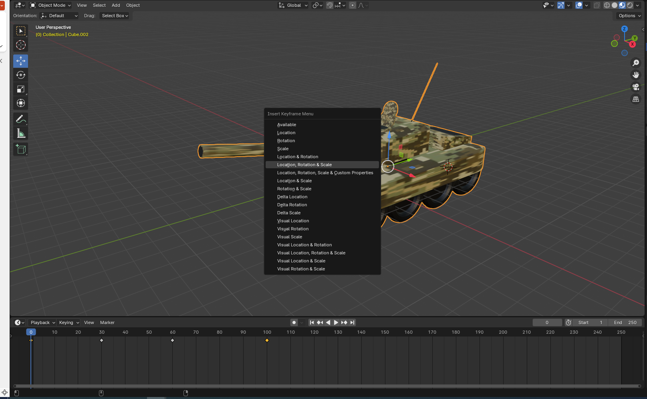
Adding animation (Part 2)
Select the object you wish to animate
Set the timer to 0
Press i on your keyboard and then select ‘location, rotation & scale’

Slide 15
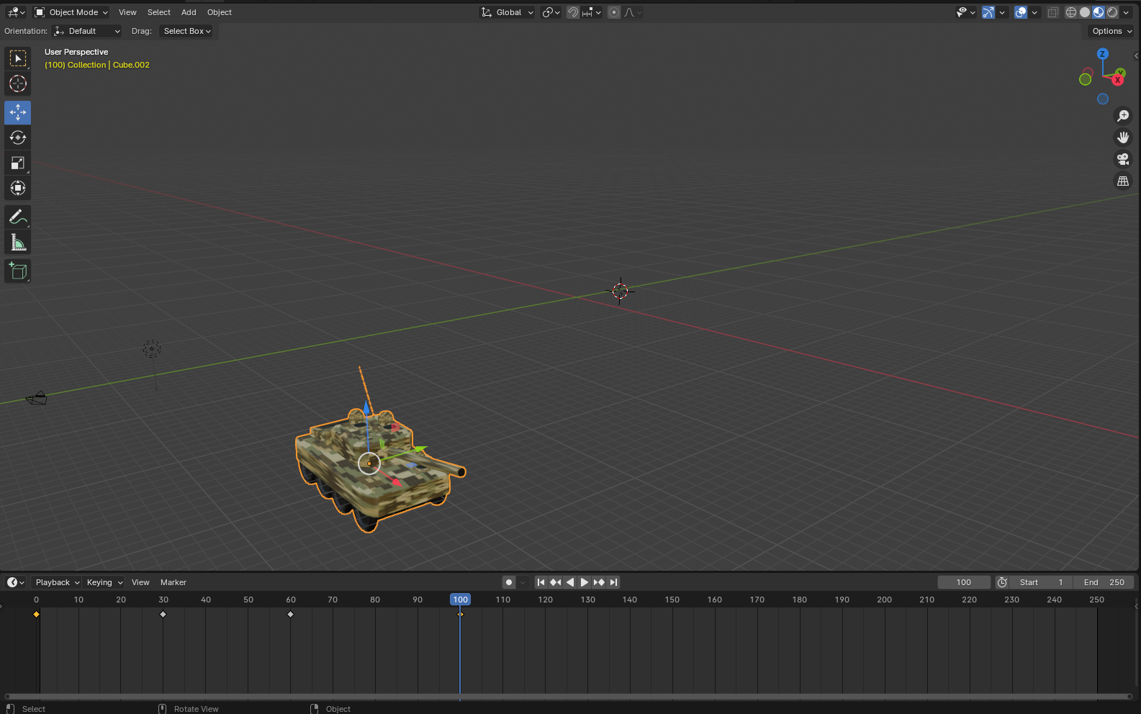
Adding animation (Part 3)
Select the object you wish to animate
Advance the timer
Move, rotate and scale your object using the common tools (slide 4)
Press i on your keyboard and then select ‘location, rotation & scale’

Slide 16
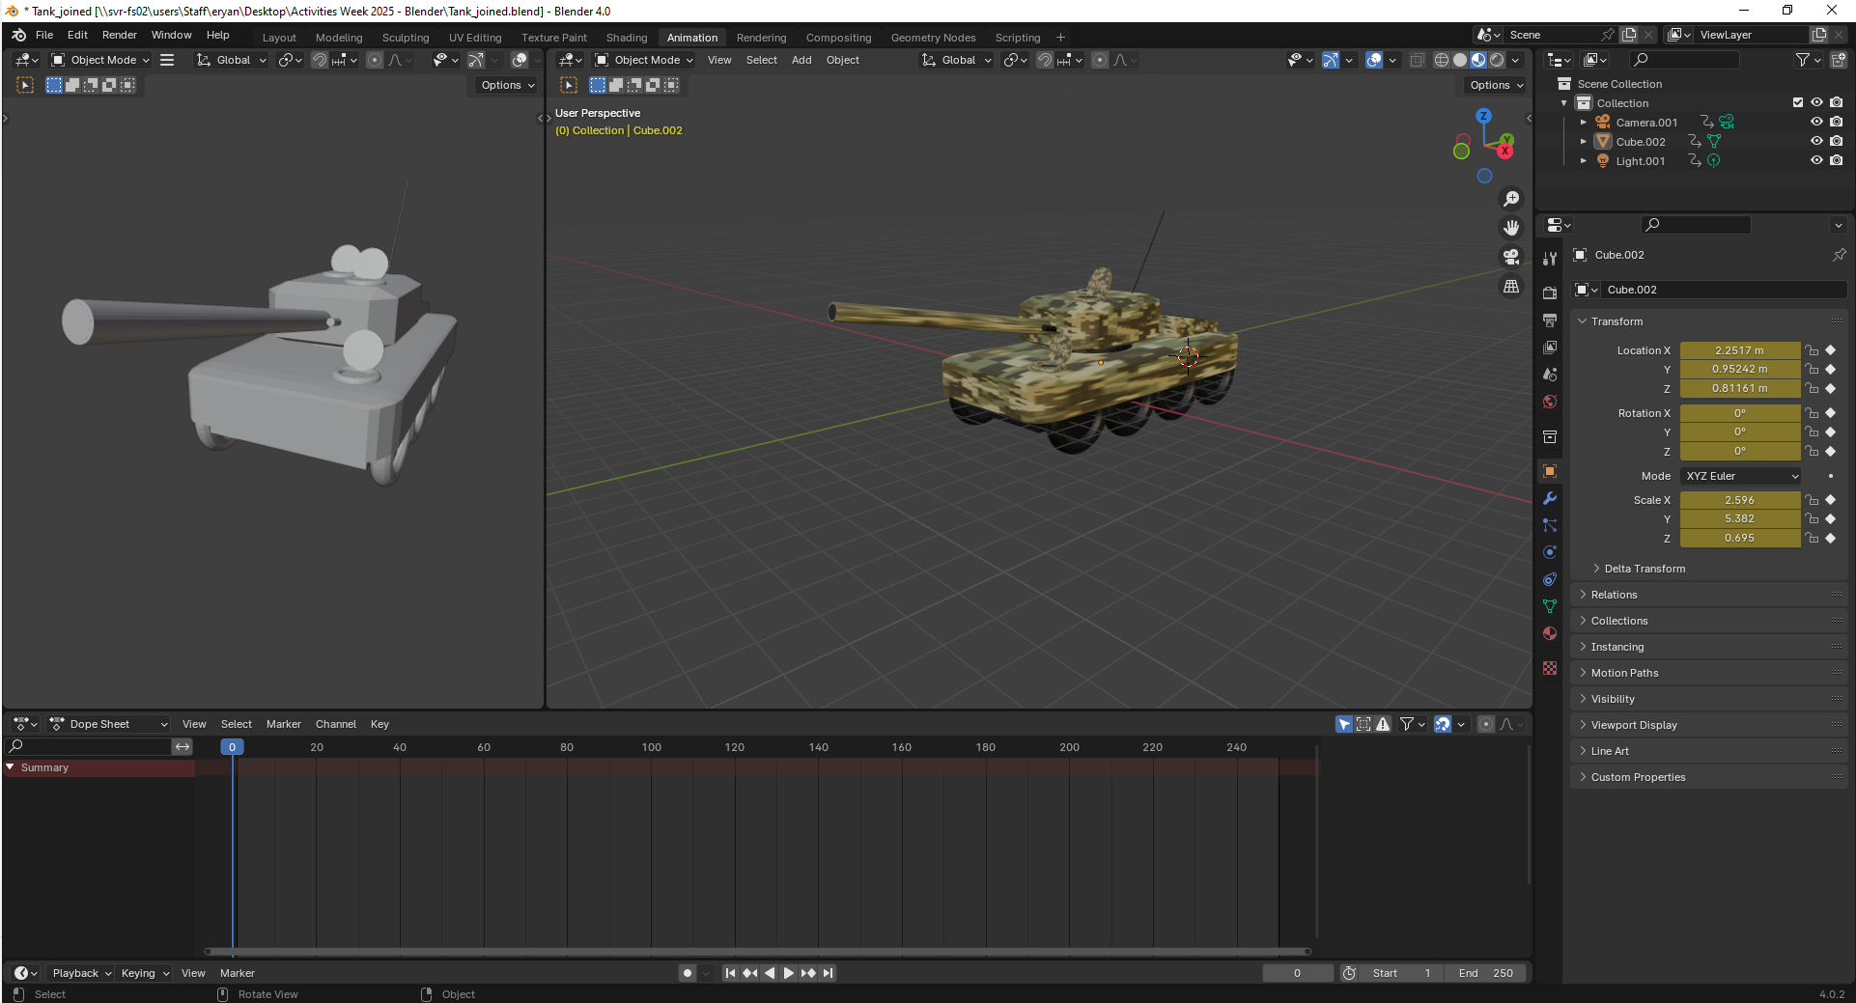
Adding animation (Part 4)
Preview and watch your animation by selecting the play, rewind buttons

