Slide 1
Websites
Lesson 2 – Images

Slide 2
Do Now
How many different types of heading tags are there?
If an opening tag is <H1> what would the closing tag be?
What button on a keyboard refreshes a web page in a browser?
What is the shortcut to save a file?

Slide 3
Skills checklist
Practising existing skills:
  Saving HTML file
  Opening HTML file
  Windows side-by-side
  Tags
    HTML
    Head
    Body
    Title
    Heading
    Paragraph
Learning new skills:
  Tags
    Image
    Page Break
    Horizontal Rule

Slide 4
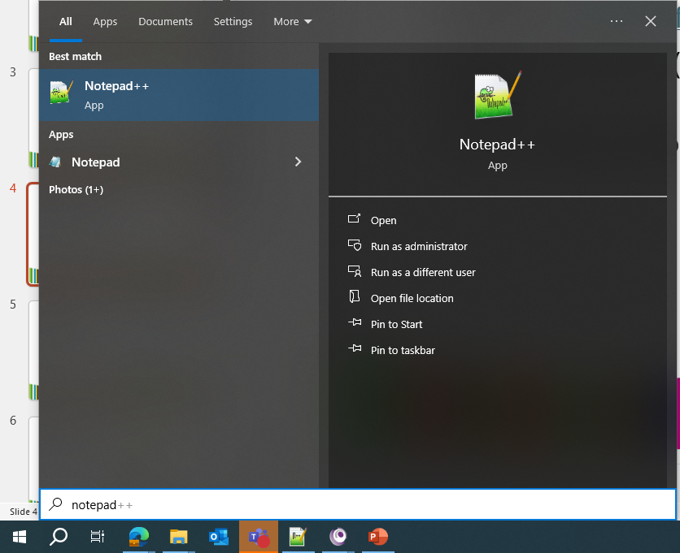
Launching Notepad++
From the Windows menu, search for Notepad++
Open Notepad++

Slide 5
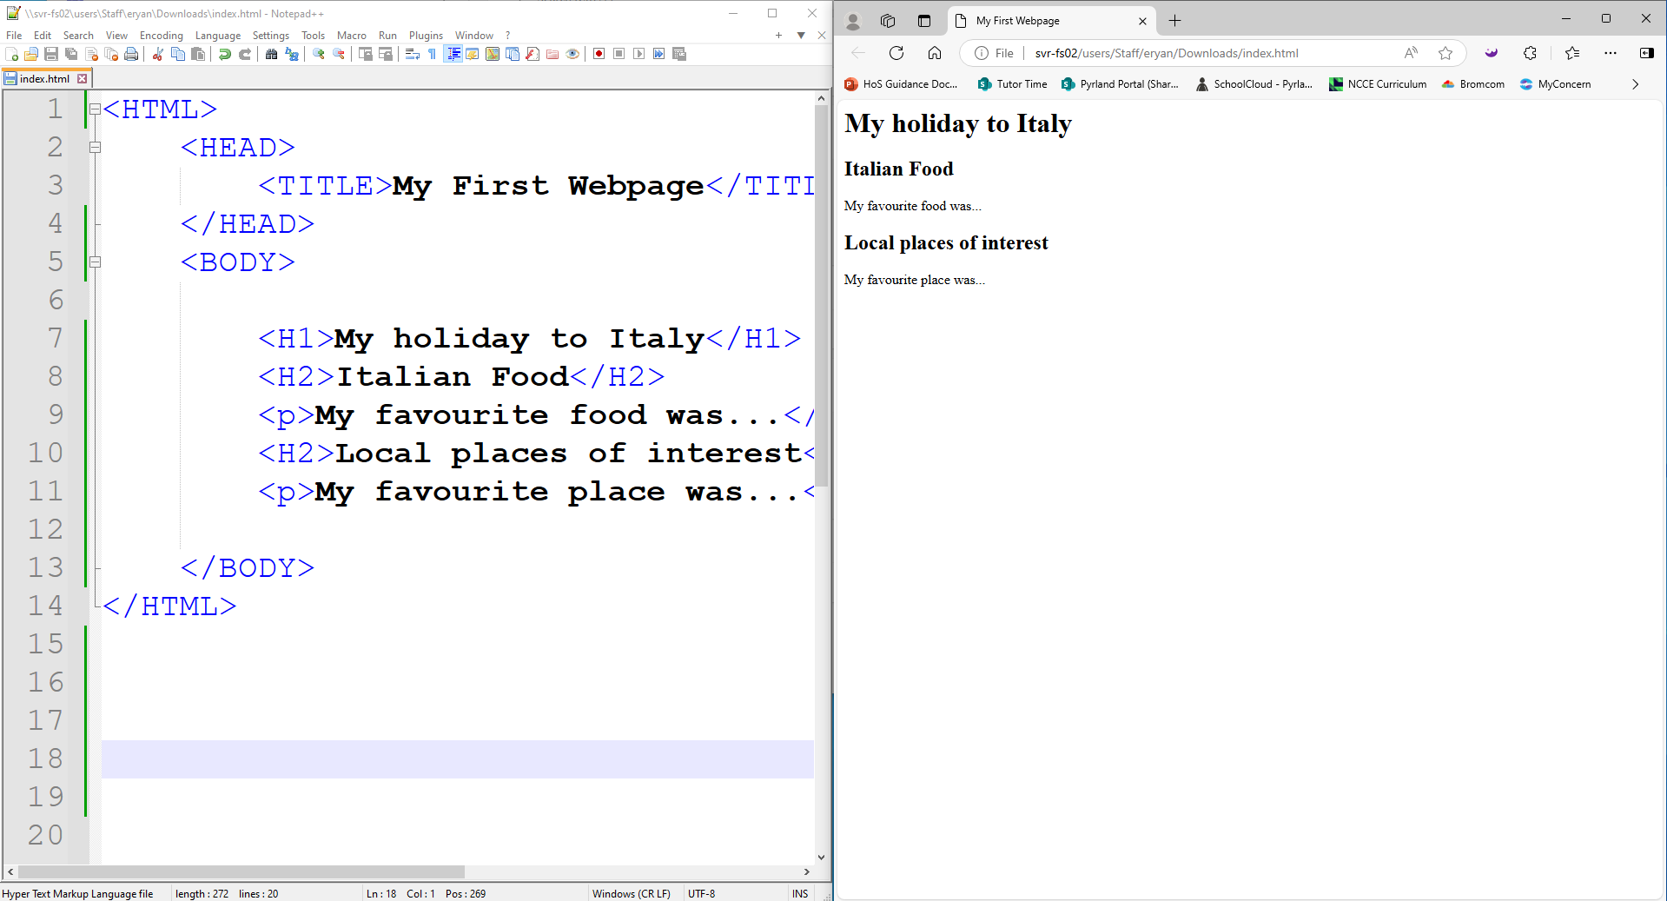
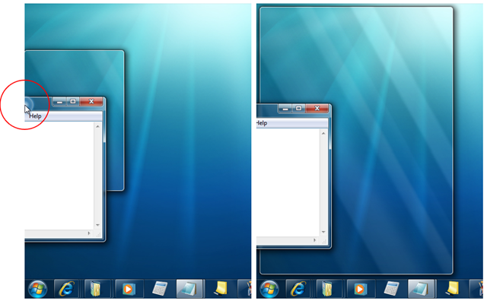
Screen Layout
A recommended layout is to have your Notepad++ window and your browser window side-by-side.
This allows you to save and view your results more easily.
To position a window you can drag it to the middle side of your screen (on left or right) and it will snap to half a screen.

Slide 6
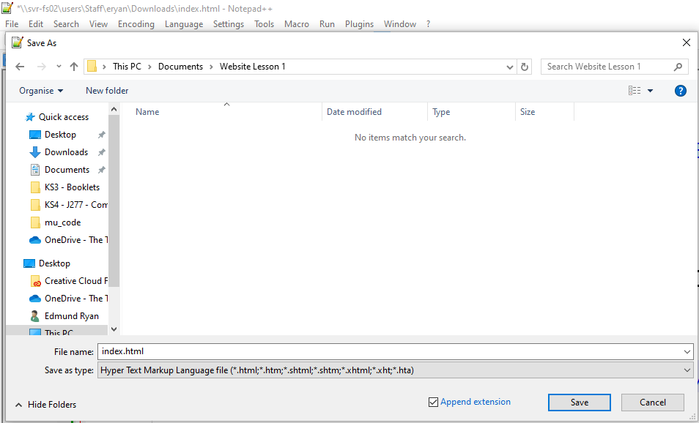
Saving
To save your work for the first time go to File > Save As
Navigate to the folder you would like to save your work to (Create a new folder if needed)
Give the file a name such as index.html

Slide 7
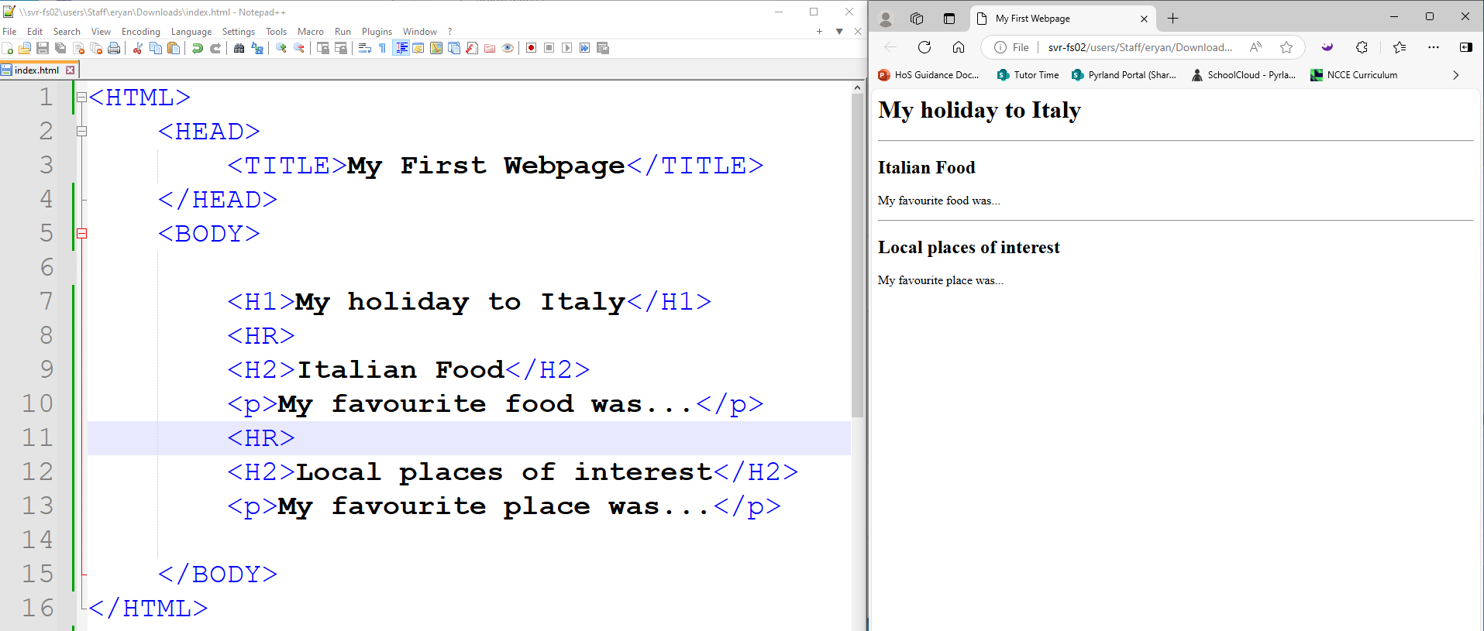
Step 1 – Horizontal Rule
The Horizontal Rule <HR> tag can be used to separate different parts of the web page.
Try adding some to your web page to help separate the sections.

Slide 8
Step 2 – Horizontal Rule
The Horizontal Rule <HR> tag can be used to separate different parts of the web page.
Try adding some to your web page to help separate the sections.
The HR tag does not have a closing tag

Slide 9
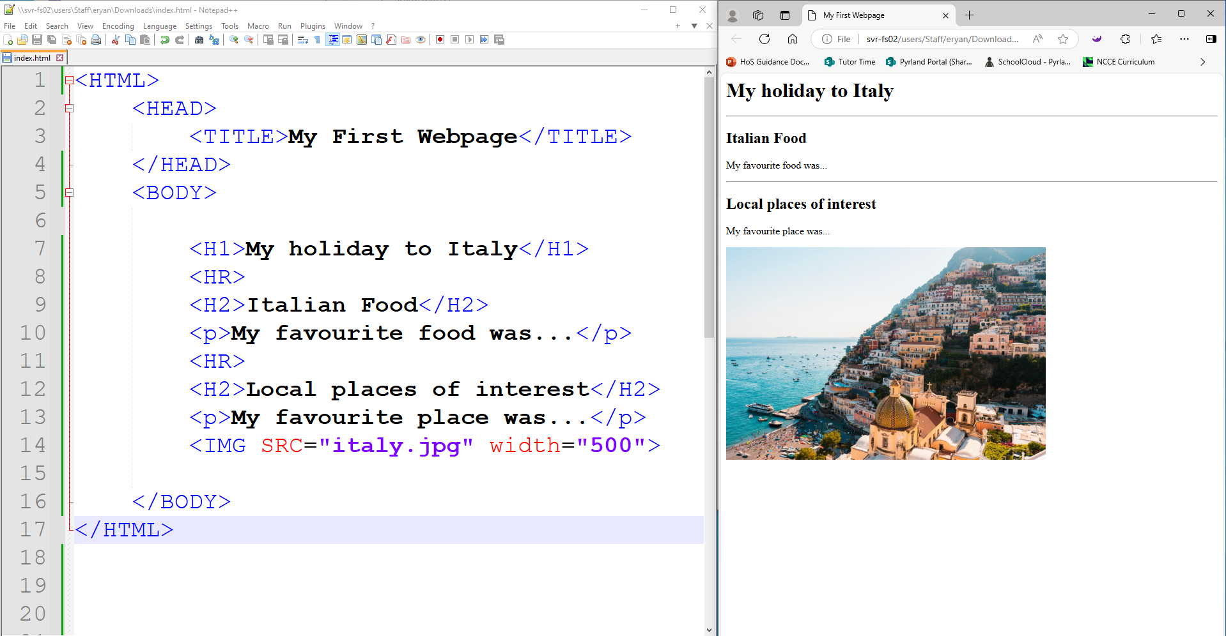
Step 3 – Images
The Horizontal Rule <IMG> tag can be used add in an image.
The IMG tag does not have a closing tag
If the image doesn’t display, check that it is in the same folder as your webpage and that the file name and extension match exactly.

Slide 10
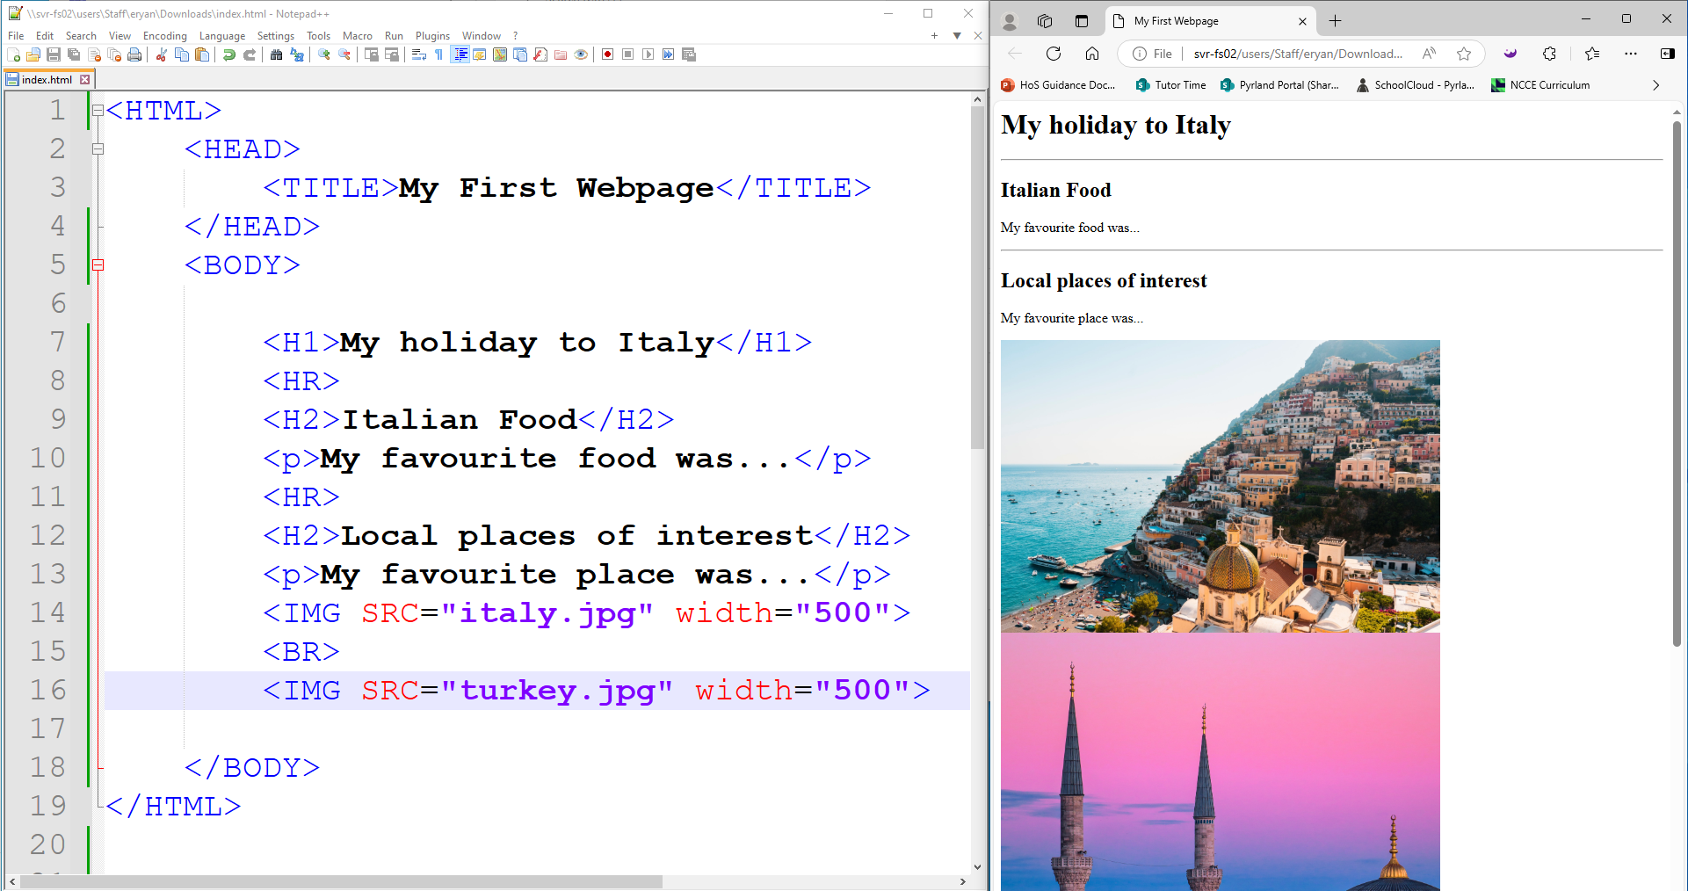
Step 3 – Page Break
The Page Break <BR> tag can be used add a gap between lines.
The <BR> tag does not have a closing tag.
The BR tag is useful if you want to push content on to the next line.

