Slide 1
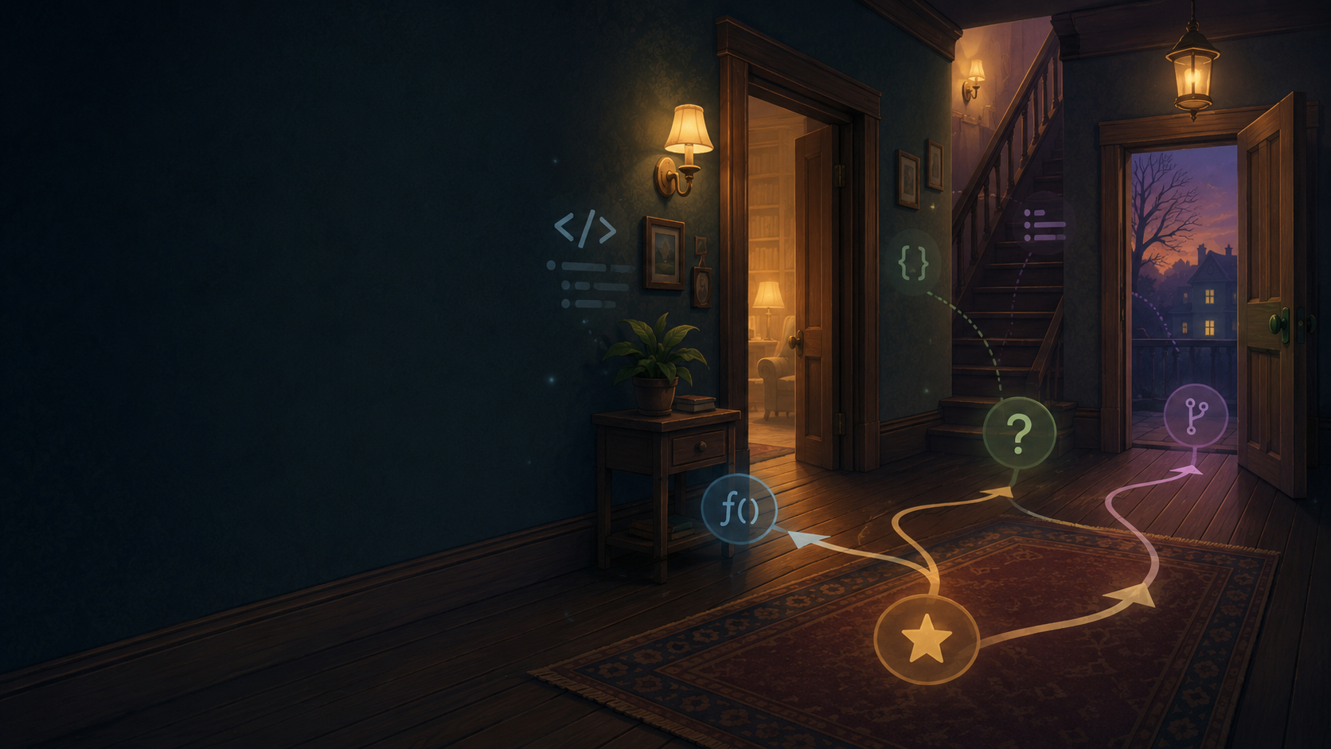
Storymaker
Python Challenge
Build and extend an interactive text adventure
functions
loops
if / elif / else
debugging
Teacher deck
Based on the uploaded Storymaker.py template

Slide 2
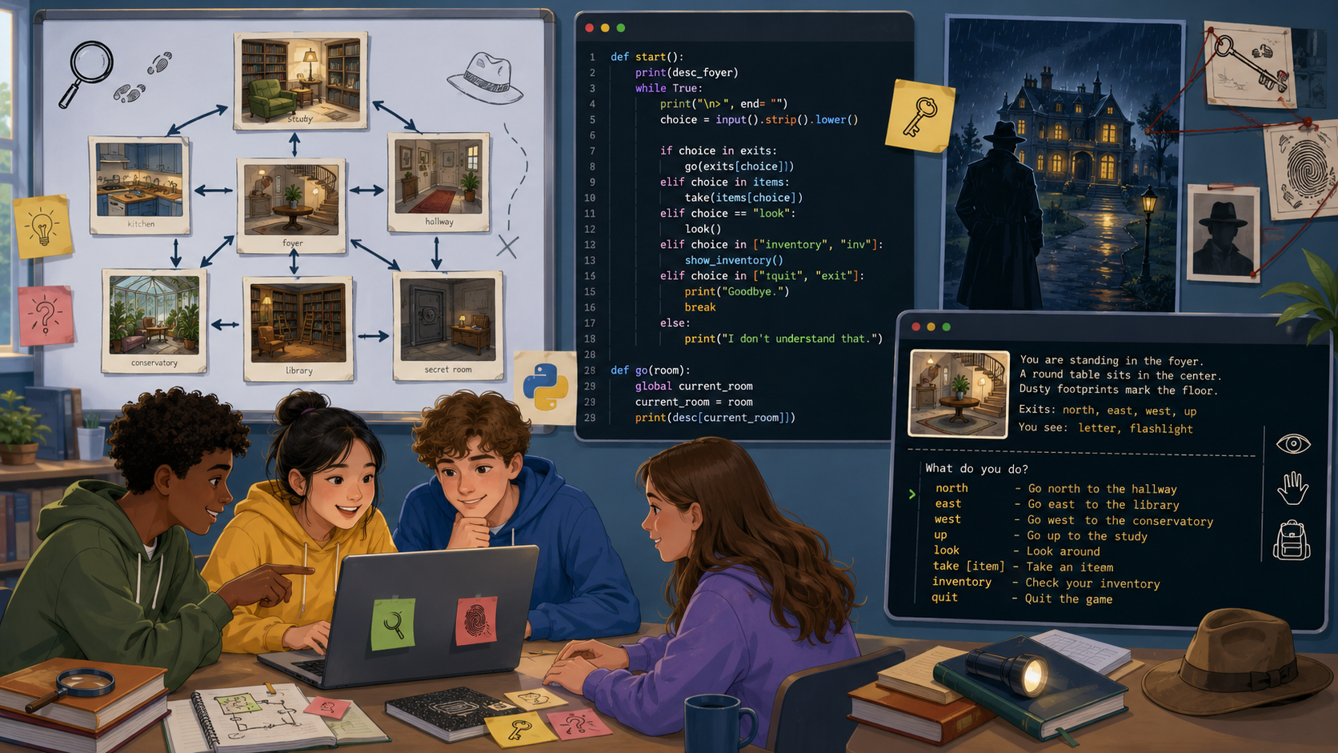
The challenge in one sentence
Students turn a working Python template into a playable mystery story.
Start with structure.
Add creativity.
Prove it works.
1
Explore
2
Adapt
3
Test
•
A complete house map is already available.
•
Every room uses a repeated choice menu.
•
The challenge scales from editing text to building new rooms.
Storymaker Python Challenge
02

Slide 3
Learning outcomes
Use the lesson to move from reading code to purposeful changes.
BY THE END STUDENTS CAN
SUCCESS LADDER
•
Explain how functions represent rooms and actions.
Bronze
Edit existing responses
•
Use while loops to keep a menu running.
•
Use if / elif / else to branch based on user input.
Silver
Add a new choice inside a room
•
Customise output to improve story atmosphere.
•
Add, test, and debug a new option or room.
Gold
Create a new room and connect it
Platinum
Add an inventory, score, or ending
Storymaker Python Challenge
03

Slide 4
How the game runs
The program is a network of functions that call each other.
Teaching point
The program does not “move” a player object. It moves by calling another function.
start()
hallway()
input()
if / elif
choice
room
function
Most rooms loop until the player chooses the door, then call the hub again.
Storymaker Python Challenge
04

Slide 5
Code detective: hallway()
Read the code like a map of possible routes.
def hallway():
flag = True
while flag:
choice = input("d1, d2, d3, d4 or s? ")
if choice.lower() == "d1":
flag = False
door1()
elif choice.lower() == "s":
flag = False
staircase("u")
else:
print("Try again.")
flag
A Boolean that controls whether the menu keeps repeating.
while
Creates the repeated choice loop.
input
Waits for the user to type a route.
function call
door1() changes the current location by running another block of code.
else
Catches invalid choices and gives feedback.
Storymaker Python Challenge
05

Slide 6
The decision pattern
Every menu follows the same idea: normalise input, compare, then respond.
choice = input("Where now? ")
if choice.lower() == "f":
print("At the fireplace...")
elif choice.lower() == "d":
print("Leaving the room")
flag = False
hallway()
else:
print("Try again.")
Why choice.lower()?
•
It converts input to lower case.
•
F, f, and even Fireplace can be handled more carefully later.
•
It reduces avoidable input errors.
Ask students:
What will happen if the player types x?
Storymaker Python Challenge
06

Slide 7
Functions are rooms
The story map can be drawn as a simple network.
door2
Kitchen
door5
Bedroom
door1
Office
door6
Master
hallway()
staircase()
landing()
door3
Living room
door7
Child room
door4
Games room
door8
Bathroom
13 functions in the starter code: 8 rooms, 2 hubs, staircase, Peter dialogue, and start.
Storymaker Python Challenge
07

Slide 8
Beginner task: build atmosphere
Keep the code structure. Change the text the player sees.
Before
Make every clue do one job:
if choice.lower() == "f":
print("At the fireplace you see... <edit this response>")
•
create mood
•
reveal a clue
•
mislead the player
After
reward exploration
•
if choice.lower() == "f":
print("Grey ash hides half of a torn note. It says: 'Find Peter.'")
Teacher prompt:
Which description makes you want to keep playing?
Storymaker Python Challenge
08

Slide 9
Intermediate task: add a new option
Students modify both the prompt and the branching logic.
choice = input("You can see a (F)ireplace, (R)ug, and (D)oor. ")
if choice.lower() == "f":
print("The fireplace is cold.")
elif choice.lower() == "r":
print("Under the rug you find a small brass key.")
elif choice.lower() == "d":
flag = False
hallway()
1
Add it to the prompt
Common mistake: adding a new choice to the prompt but forgetting the matching elif.
2
Add an elif branch
3
Write the response
4
Test valid and invalid input
Storymaker Python Challenge
09

Slide 10
Expert task: add a new room
New rooms need a function, a route into it, and a way back.
def cellar():
print("**You enter the cellar**")
flag = True
while flag == True:
choice = input("You can see a (B)ox and a (D)oor. ")
if choice.lower() == "b":
print("Inside the box is a muddy footprint.")
elif choice.lower() == "d":
flag = False
hallway()
else:
print("Your choice wasn't recognised.")
Connection checklist
•
Create the new function.
•
Add the option to hallway() or landing().
•
Call the function when the option is chosen.
•
Return to the correct hub when the player exits.
No route = unreachable room
Storymaker Python Challenge
10

Slide 11

Debugging hunt
Use the starter code to practise spotting logic and input problems.
Bug 1
Door 4 prints “You are in Room 1”.
Bug 2
Door 6 says “You are leaving Room 5”.
Bug 3
Bathroom cabinet checks for "c?" rather than "c".
Challenge
What should happen if Peter is asked question 6?
Ask students to predict the symptom before they run the code.
Storymaker Python Challenge
11

Slide 12
Plan before coding
A short plan prevents random edits and broken routes.
Story planning board
Mystery
What happened?
Rooms
Where can the player go?
Clues
What can they find?
Ending
How is it solved?
Students fill this in before editing code:
•
Which existing room will contain the first clue?
•
Which choice unlocks new information?
•
How will the player know they have finished?
Storymaker Python Challenge
12

Slide 13
Testing like a developer
Testing is not just “playing it once”. It is checking expected behaviour.
Predict
Run
Record
Fix
Retest
Useful tests for this challenge
•
Navigate from start to each room and back.
•
Try upper-case input and invalid input.
•
Check every new option has an elif branch.
•
Check the story can reach an ending.
Storymaker Python Challenge
13

Slide 14
Stretch ideas
Use these only after the basic routes are reliable.
Inventory
Locked
doors
Score or
time limit
Multiple
endings
Dictionary
refactor
Good stretch work changes the game mechanics, not only the story text.
Storymaker Python Challenge
14

Slide 15
Mini-plenary: explain the code
Use this as an exit ticket or pair discussion.
1
What does while flag == True do?
2
Why does the program use choice.lower()?
3
How does a room function return to the hallway or landing?
4
Which improvement did you make and how did you test it?
Stretch response: identify one bug in the original template and explain the fix.
Storymaker Python Challenge
15

Slide 16
Suggested lesson flow
A 60-minute structure that works with the student workbook.
Starter
5 min
Code walk
10 min
Build
25 min
Test
10 min
Review
10 min
Predict what the program does.
Trace hallway(), one room, and Peter dialogue.
Choose Bronze, Silver, Gold, or Platinum challenge.
Use the testing log and fix errors.
Exit ticket and peer review.
Differentiation built in: beginners edit responses, intermediate learners add options, experts add rooms and mechanics.
Storymaker Python Challenge
16

